Slide 1

Introduction to the Lightning Network
Protocol
Mainz
March 19th 2019

Slide 2
Disclaimer
Please note the copyright notice at the end of the slide deck
The pdf version - which you probably read has some weird formatting problems.
https://docs.google.com/presentation/d/1-eyceLlSmcLpbPJLzj6_CnVYQdo1AUP3y5XD716U-Lg has the source files without formatting problems and with animations
This slidedeck is crowd funded (see last slide) if you wish to learn more or contribute
I do not take any guarantee that the information in this slide deck are 100% correct.
Sometimes I made simplifications: which I point out
Also I could just have misunderstood something or just made a mistake

Slide 3
After this talk you will hopefully understand this slide!
Payment Hash
R → H(R)
H(R)
Bolt 11 Invoice
Alice
Find a path (for example via Bob and Charlie)
David
Alice
Bob
Charlie
David
0
300
9
Alice creates Onion package
452
300
18
Ek D
u3h4kj23048yerg2j3r
74
301
41
Ek C
aksjhdflka813r83n09aw0923kjqk34jt2kjt3jhk2jh3tqkjw
Ek B
374yiu3h4ot8h2no2iht2htp82hts98dfgoh2408h2048gh2084ghh2g0240gh24hg082h4g
HTLC
update_add_htlc
HTLC
update_add_htlc
HTLC
update_add_htlc
R
R
update_fullfil_htlc
R
update_fullfil_htlc
update_fullfil_htlc

Slide 4
Outline: Understand the Lightning Network
Construction of Payment channels (RSMCs)
The payment process (based on invoices)
Trustless routing of payments via a network of channels (HTLCs)
Source based onion routing (SPHINX mix Format)
Transport Layer (Noise XK - Noise Protocol Framework)
Messaging / peer protocol
Gossip Protocol
Advanced Topics
Future enhancements to the BOLTs
Privacy considerations
Security breaches
By (poor) Implementations
By Services

Slide 5
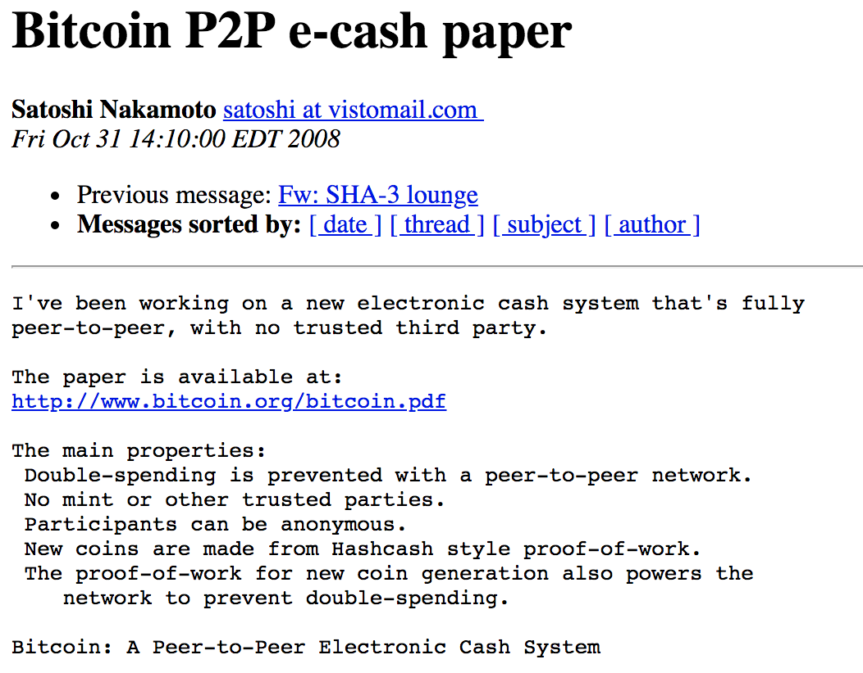
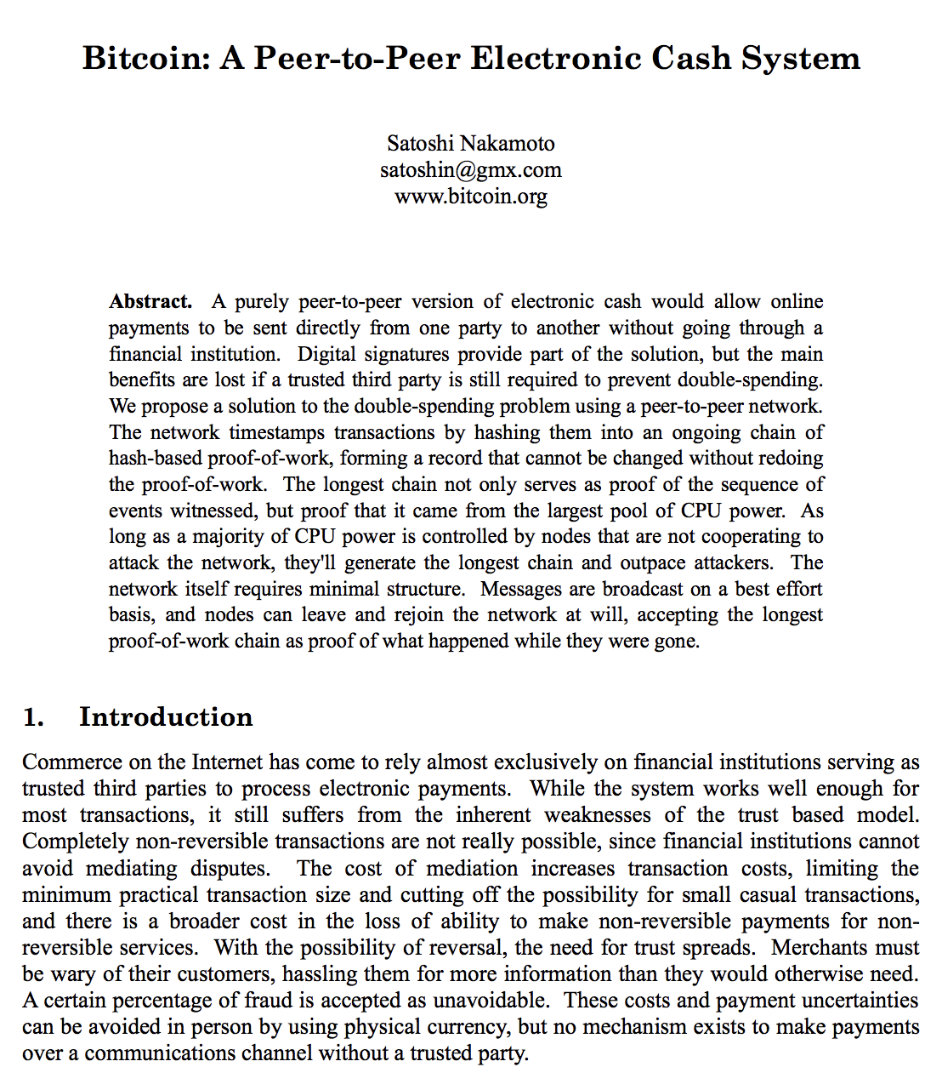
Chapter 0: Prologue
Bitcoin
Is secure
Solved the double spending problem
Created decentralized e-cash
Does not scale

Slide 6
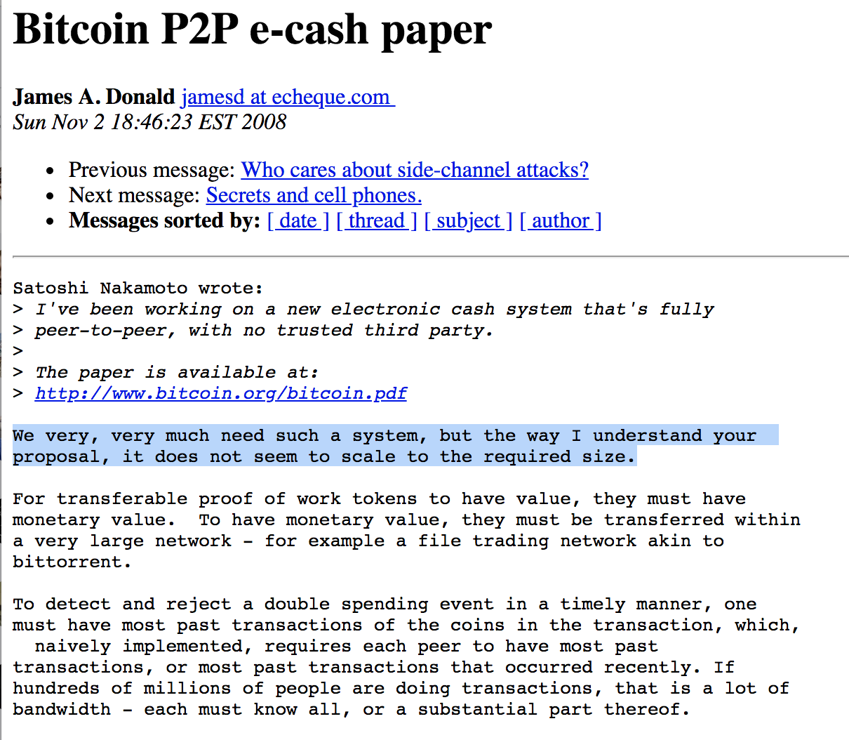
Chapter 0: Prologue

Slide 7
Why Lightning network?
Transform Bitcoin to an electronic cash system
Allow arbitrary amount of transactions
Get currency / cash property instead of store of value
Make payments more anonymous
Don't store all payments on chain
Allow for instant peer to peer payments
No need to wait for block confirmations
In other words to scale Bitcoin
And of course because…
we can … (:

Slide 8
3 Building blocks of the Lightning Network
Duplex Micropayment Channels
Revocable Sequence Maturity Contracts (RSMCs)
Penalty based invalidation mechanism
Value transfer in a network of payment channels
Comparing the payment process in Bitcoin with the Lightning Network
Hashed Time Lock Contracts (HTLCs)
Onion Routing based on the SPHINX Mix Format
Communication protocol
Transport layer with strong encryption
The peer protocol
Gossip protocol to create a P2P network

Slide 9
Construction of Payment channels (RSMCs)
(Chapter 1)

Slide 10
Purpose of a trustless bidirectional payment channel
Sending payments between two partners
Instantly
Like updating a balance sheet
Only bound by network traffic over the internet
No direct involvement of the blockchain (as long as everyone plays by the rules)
No need for any partner to trust the other side
The bitcoin network (and the blockchain) needs to be trusted
The bitcoin network will settle conflicts if they arise
No fees or overhead when sending payments within the channel
Payments can go in either direction back and forth
Scale usage of Bitcoin
transfer of value can be achieved without hitting the blockchain
→ How can this technically be possible?

Slide 11
A comparison with HTTP
HTTP is a Request Response Protocol by design
You (the client / Browser) can make a request
The server gives you a response
According to the protocol a server cannot initiate communication with a client
How can a website (e.g. Twitter) give us a notification that some new data is there?
By abusing the protocol
aka: Server push, long polling,
Took us about 10 years to figure that out

Slide 12
How does a HTTP server push work?
You load a web page
Javascript (AJAX) initiates an HTTP request
Server looks if he has some information for the client
If yes → response
If no → defer answering to that request to some time in the future
If new information for the client is available
If client opens a new page and can't receive that response anymore
Just as a heartbeat mechanism to ask the client to make a new request
From an end user perspective the server has initiated a conversation
The end user is usually not aware of the fact that an AJAX Request is outstanding
More details at: https://en.wikipedia.org/wiki/Push_technology

Slide 13
Payment channels are constructed by deferring the publication or broadcast of some TXs to the future
Bitcoin is not a request response protocol
Rather a broadcast / gossip protocol
What exactly is being deferred to the future?
Transactions spending outputs are held back from being broadcasted
Later Transactions are purposely tried to be double spent
Obviously only one of the transactions can be actually spent
Lightning is about making sure it is the correct one
We look at this in the next couple slides
Payment channels are to Bitcoin what HTTP Server Push is to HTTP
Just a non obvious use of the Bitcoin protocol
It took us a little while to figure this feature of Bitcoin out (as for HTTP)

Slide 14
A payment channel is a 2-2 multisig Address together with some (smart?) contract
A 2-2 multisig Address means that the output script of a transaction requires 2 keys in order to be able to spend the transaction
It is a form of Pay to Script Hash
scriptPubKey (OUTPUT): OP_HASH160 <scriptHash> OP_EQUAL
scriptSig (INPUT): ...<signatures>... <serialized script>
Case of a m-of-n multi-signature
The OUTPUT script (scriptPubKey) as above
OP_HASH160 <scriptHash> OP_EQUAL
The INPUT Script to spend the scriptPubKey looks like this:
scriptSig: 0 <sig1>...<serialized script>
Script: OP_m <pubKey1> … OP_n OP_CHECKMULTISIG

Slide 15
The secret smart contract (RSMC)
The 2-2 multisig wallet has some funds
Seen on chain
Who owns these funds?
Channel partners do not share the 2 private keys
Depends on how the funds are being spent
The Transaction spending from the 2-2 Wallet
Will be kept secret (if possible)
Will encode the balance
Is called a commitment transaction (has to be signed BEFORE publishing funding tx)
Technical details
Will be heavily attempted to be double spent (which by the bitcoin protocol is impossible)
Secures funds with timelocks
Allows for conditional hashed time locked outputs (used in routing)
Revocable sequence maturity contract

Slide 16
Funding Transaction
Output x
(100 mBTC)
Alice's Key
U
N
P
U
B
L
I
S
H
E
D
Legend for colors:
Broadcasted and mined
Not boradcasted
Should be broadcasted
Should not be broadcasted
Cannot by minded
(Consumed outputs are already spent)
Reference
Funding Transaction
Input (100 mBTC)
Output 0
(100 mBTC)
Alice's & Bob's Key
Inside
ScriptPubKey:
OP_HASH160 <scriptHash> OP_EQUALVERIVY

Slide 17
Funding Transaction
Output x
(100 mBTC)
Alice's Key
sigScript:
<sig1>... <serializedScript>
Script:
OP_2 <Alice><Bob> OP_2 OP_CHECKMULTISIG
U
N
P
U
B
L
I
S
H
E
D
Reference
Inside
Funding Transaction
Commitment Transaction 1
Input (100 mBTC)
Input (100 mBTC)
Reference
Output 0
(100 mBTC)
Alice's & Bob's Key
Output 0
(70 mBTC)
Alice's Key
Output 1
(30 mBTC)
Bob's Key
Inside
ScriptPubKey:
OP_HASH160 <scriptHash> OP_EQUALVERIVY

Slide 18
Funding Transaction
Output x
(100 mBTC)
Alice's Key
sigScript:
<sig1>... <serializedScript>
Script:
OP_2 <Alice><Bob> OP_2 OP_CHECKMULTISIG
U
N
P
U
B
L
I
S
H
E
D
Reference
Inside
Funding Transaction
P
U
B
L
I
S
H
E
D
Commitment Transaction 1
Input (100 mBTC)
Input (100 mBTC)
Reference
Output 0
(100 mBTC)
Alice's & Bob's Key
Output 0
(70 mBTC)
Alice's Key
Output 1
(30 mBTC)
Bob's Key
Inside
This Commitment Transaction (CTX1) encodes the balance sheet of the channel.
It can be broadcasted to the blockchain at any time
Funding Tx must use segWit outputs to prevent malleability
ScriptPubKey:
OP_HASH160 <scriptHash> OP_EQUALVERIVY

Slide 19
With CTX2 Bob updates the channel Balance
Funding Transaction
Commitment Transaction 1
Input (100 mBTC)
Input (100 mBTC)
Reference
Output 0
(100 mBTC)
Alice's & Bob's Key
Output 0
(70 mBTC)
Alice's Key
Output 1
(30 mBTC)
Bob's Key
Reference
Bob effectively sends 10 mBTC
to Alice
potential
double spending?
Commitment Transaction 2
Input (100 mBTC)
Output 0
(80 mBTC)
Alice's Key
Output 1
(20 mBTC)
Bob's Key

Slide 20
Anybody seeing a problem with this?
Funding Transaction
Commitment Transaction 1
Input (100 mBTC)
Input (100 mBTC)
Reference
Output 0
(100 mBTC)
Alice's & Bob's Key
Output 0
(70 mBTC)
Alice's Key
Output 1
(30 mBTC)
Bob's Key
Reference
potential
double spending?
Commitment Transaction 2
Input (100 mBTC)
Output 0
(80 mBTC)
Alice's Key
Output 1
(20 mBTC)
Bob's Key

Slide 21
Bob broadcasts CTX1 which is successfully mined
Bob just effectively stole 10 mBTC from Alice
Funding Transaction
Commitment Transaction 1
Input (100 mBTC)
Input (100 mBTC)
Reference
Output 0
(100 mBTC)
Alice's & Bob's Key
Output 0
(70 mBTC)
Alice's Key
Output 1
(30 mBTC)
Bob's Key
Reference
Commitment Transaction 2
Input (100 mBTC)
Output 0
(80 mBTC)
Alice's Key
Output 1
(20 mBTC)
Bob's Key

Slide 22
Goal: Make old CTXs somehow unpublishable
Funding Transaction
Commitment Transaction 1
Modify the output of the CTX
Fraudulent publishing will punish the publisher
For example by giving the silent party the opportunity to claim all outputs of the CTX
Input (100 mBTC)
Input (100 mBTC)
Reference
Output 0
(100 mBTC)
Alice's & Bob's Key
Output 0
(70 mBTC)
Alice's Key
Output 1
(30 mBTC)
Bob's Key
Reference
Commitment Transaction 2
Input (100 mBTC)
Output 0
(80 mBTC)
Alice's Key
Output 1
(20 mBTC)
Bob's Key

Slide 23
We modify the output scripts of CTXs that it can be spent by either one of the two Transactions
Reference
Commitment Transaction 1b (Bob)
Revocable Delivery 1b (Bob)
Breach Remedy Tx 1b (Bob)
Input (100 mBTC)
Input (30 mBTC)
Input (30 mBTC)
Output 0 (30 mBTC)
Bob's Key
Relative Time Lock (144)
Output 0 (30 mBTC)
Bob's & Alice's
Revocation Key #1
Output 0
(70 mBTC)
Alice's Key
Output 1
(30 mBTC)
RSMC
ScriptPubKey: (Output0)
OP_HASH160 <Alice's key> OP_EQUALVERIFY OP_CHECKSIG
Script: (Input Script to be able to spend Output1)
OP_IF
144 OP_CECKSEQUENCEVERIFY
OP_ DUP OP_HASH160 <Bob's key> OP_EQUALVERIFY OP_CHECKSIG
OP_ELSE
2 <Alice R_1><Bob R_1> 2 OP_CHECKMULTISIGVERIFY
OP_ENDIF
potential
double spending?

Slide 24
Within 144 Blocks after CTX1b is mined only Alice can spend Output1 (if she has Bob's Revocation Key)
Reference
Commitment Transaction 1b (Bob)
Revocable Delivery 1b (Bob)
Breach Remedy Tx 1b (Bob)
Input (100 mBTC)
Input (30 mBTC)
Input (30 mBTC)
Output 0 (30 mBTC)
Bob's Key
Relative Time Lock (144)
Output 0 (30 mBTC)
Bob's & Alice's
Revocation Key #1
Output 0
(70 mBTC)
Alice's Key
Output 1
(30 mBTC)
RSMC
ScriptPubKey: (Output0)
OP_HASH160 <Alice's key> OP_EQUALVERIFY OP_CHECKSIG
Script: (Input Script to be able to spend Output1)
OP_IF
144 OP_CECKSEQUENCEVERIFY
OP_HASH160 <Bob's key> OP_EQUALVERIFY OP_CHECKSIG
OP_ELSE
2 <Alice R_1><Bob R_1> 2 OP_CHECKMULTISIGVERIFY
OP_ENDIF

Slide 25
After 144 Blocks Bob can redeem his 10 mBTC & Alice can't spent BRTX1b without Bob's Key
Reference
Commitment Transaction 1b (Bob)
Revocable Delivery 1b (Bob)
Breach Remedy Tx 1b (Bob)
Input (100 mBTC)
Input (30 mBTC)
Input (30 mBTC)
Output 0 (30 mBTC)
Bob's Key
Relative Time Lock (144)
Output 0 (30 mBTC)
Bob's & Alice's
Revocation Key #1
Output 0
(70 mBTC)
Alice's Key
Output 1
(30 mBTC)
RSMC
ScriptPubKey: (Output0)
OP_HASH160 <Alice's key> OP_EQUALVERIFY OP_CHECKSIG
Script: (Input Script to be able to spend Output1)
OP_IF
144 OP_CECKSEQUENCEVERIFY
OP_HASH160 <Bob's key> OP_EQUALVERIFY OP_CHECKSIG
OP_ELSE
2 <Alice R_1><Bob R_1> 2 OP_CHECKMULTISIGVERIFY
OP_ENDIF

Slide 26
A new Commitment Transaction is only signed if the other party reveals their previous revocation Key
Reference
Commitment Transaction 1b (Bob)
Revocable Delivery 1b (Bob)
Breach Remedy Tx 1b (Bob)
Input (100 mBTC)
Input (30 mBTC)
Input (30 mBTC)
Output 0 (30 mBTC)
Bob's Key
Relative Time Lock (144)
Output 0 (30 mBTC)
Bob's & Alice's
Revocation Key #1
Output 0
(70 mBTC)
Alice's Key
Output 1
(30 mBTC)
RSMC
Commitment Transaction 2b (Bob)
Revocable Delivery 2b (Bob)
Breach Remedy Tx 2b (Bob)
Input (100 mBTC)
Input (20 mBTC)
Input (20 mBTC)
Output 0
(80 mBTC)
Alice's Key
Output 1
(20 mBTC)
RSMC
Output 0 (20 mBTC)
Bob's Key
Relative Time Lock (144)
Output 0 (20 mBTC)
Bob's & Alice's
Revocation Key #2

Slide 27
Assume CTX1b is published and mined. Alice should immediately publish BRTX1b to punish Bob's breach
Reference
Commitment Transaction 1b (Bob)
Revocable Delivery 1b (Bob)
Breach Remedy Tx 1b (Bob)
Input (100 mBTC)
Input (30 mBTC)
Input (30 mBTC)
I
M
P
O
S
S
I
B
L
E
D
O
U
B
L
E
S
P
E
N
D
I
N
G
Output 0 (30 mBTC)
Bob's Key
Relative Time Lock (144)
Output 0 (30 mBTC)
Bob's & Alice's
Revocation Key #1
Output 0
(70 mBTC)
Alice's Key
Output 1
(30 mBTC)
RSMC
Commitment Transaction 2b (Bob)
Revocable Delivery 2b (Bob)
Breach Remedy Tx 2b (Bob)
Input (100 mBTC)
Input (20 mBTC)
Input (20 mBTC)
Output 0
(80 mBTC)
Alice's Key
Output 1
(20 mBTC)
RSMC
Output 0 (20 mBTC)
Bob's Key
Relative Time Lock (144)
Output 0 (20 mBTC)
Bob's & Alice's
Revocation Key #2

Slide 28
Some remarks on presented simplifications
In order to be able to ascribe blame both sides get their own CTXs
Commitment Tx 1b, 2b, 3b,... (for Bob)
Commitment Tx 1a, 2a, 3a,... (for Alice)
Transactions for every channel update
The Revocation Deliver TXs and the Breach Remedy TXs are adapted accordingly
For every Update of the CTXs new Revocation Keys have to be created
Otherwise revealing the key once would not help for future updates
Future Breach Remedy Transactions could be spent directly
They are created from a Hierarchical Deterministic Wallet
The Commitment Transactions will have even more outputs to support HTLCs
HTLC outputs will be needed for routing third party payments through one's channel
Reading suggestion for a payment channel construction with less Overhead
eltoo: A Simple Layer2 Protocol for Bitcoin
Christian Decker, Rusty Russell (Blockstream)
Olaoluwa Osuntokun (Lightning Labs)
Summary at https://www.rene-pickhardt.de/thoughts-about-eltoo-another-protocol-for-payment-channel-management-in-the-lightning-network/

Slide 29
Some remarks on dust outputs
In Bitcoin outputs MUST have a certain amount otherwise
the fees will be higher to spend the output than the amount attached to it
the blockchain can be spammed
Dust limit depends on the script and is a few hundred satoshis.
C.f.: https://bitcoin.stackexchange.com/questions/10986/what-is-meant-by-bitcoin-dust
If outputs in the commitment transaction are below the dust limit
they will be omitted
added to the fees
While lightning supports tiniest payments those amounts cannot always be enforced on chain
Making tiny payments / routing tiny amounts might make you lose those
Lighting implementations can be configured to not accept payments under a certain threshold

Slide 30
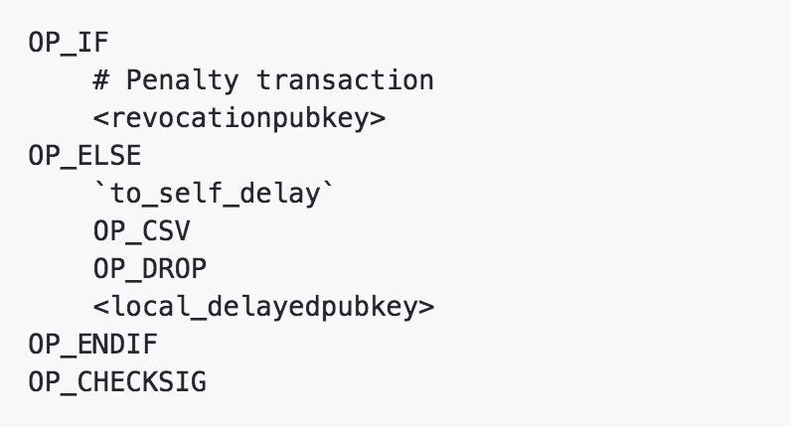
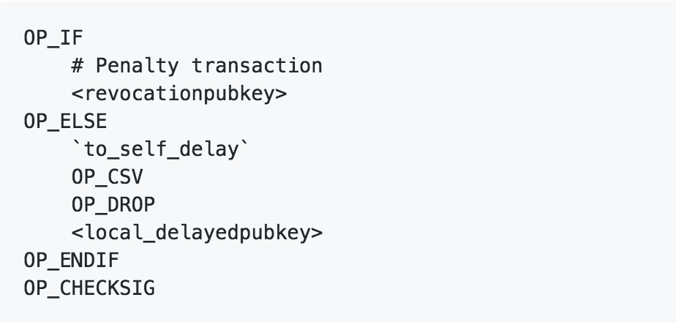
Standard to_local witness script for commitment txs

Slide 31
Summary of what we have achieved now
Bidirectional payment channel is opened with one on chain transaction
Channel can stay open for arbitrary time
The newest Commitment Transaction encodes the balance of a channel
Old Commitment Transactions are invalidated to prevent broadcasting them
Achieved by sharing private keys to effectively allow the other side to spend the output
The balance sheet can instantly be updated
Effectively allowing each party to send funds to the other party
Both parties need to collaborate for this to happen
Blockchain doesn't need to get involved
No fees for updating the balance within the payment channel
Where is the (Lightning) Network of payment channels?

Slide 32
The Payment Process on the Lightning Network
(Chapter 2 / BOLT 11)

Slide 33
Comparing the payment process of on chain Bitcoin and off chain Lightning Network payments
Bitcoin address is like a bank account number
Bitcoins can be sent to that address
Payment requests in Bitcoin exist to have a smoother User experience
Lightning cannot send money to another lightning node without invoice
unless you use dirty low level routing tricks (https://www.youtube.com/watch?v=Dwl-0cY6KkU)
Spontaneous payment extension by lnd in progress
In Lightning the recipient or payee first has to issue an invoice
The payer in lightning pays the invoice in return for a secret preimage
You could probably call it a receipt.
What does it have to do with routing and the fact that lightning is a network?
Also look at: https://www.youtube.com/watch?v=Ol12GrAy8yk

Slide 34
Direct physical Payment with cash
Ask for the price
How much?

Slide 35
Direct physical Payment with cash
10 $
Ask for the price
How much?

Slide 36
Direct physical Payment with cash
Ask for the price
Give the money
10 $

Slide 37
Direct physical Payment with cash
Ask for the price
Give the money
Get the receipt
10 $
Here is your receipt

Slide 38
Direct physical Payment with cash
Ask for the price
Give the money
Get the receipt
Step two and three are atomic.
(At least ideally they should be atomic)
10 $
Here is your receipt

Slide 39
Direct on Chain Payment with Bitcoin
Ask for the price
Broadcast transaction
1 mBTC

Slide 40
Direct on Chain Payment with Bitcoin
Ask for the price
Broadcast transaction
See within blockchain
1 mBTC
Look in Blockchain

Slide 41
Direct on Chain Payment with Bitcoin
Ask for the price
Broadcast transaction
See within blockchain
Payment is still somewhat "atomic"
payee must have received the payment.
Payment can't be interrupted
1 mBTC
Look in Blockchain

Slide 42
Indirect physical payment with cash.
Assume there is a third party (e.g. Bank, another person) that should forward your payment
10 $
10 $
Here is your receipt
Here is your receipt

Slide 43
Indirect physical payment with cash.
Assume there is a third party (e.g. Bank, another person) that should forward your payment
Should be atomic
10 $
10 $
Here is your receipt
Here is your receipt

Slide 44
Indirect physical payment with cash.
Assume there is a third party (e.g. Bank, another person) that should forward your payment
Should be atomic
Can it though?
10 $
10 $
Here is your receipt
Here is your receipt

Slide 45
Indirect physical payment with cash.
Assume there is a third party (e.g. Bank, another person) that should forward your payment
Should be atomic
otherwise
Yeah 10$ for me (:
10 $
I have no receipt yet!

Slide 46
Indirect physical payment with cash.
Assume there is a third party (e.g. Bank, another person) that should forward your payment
Should be atomic
Make a contract!
I give you $10 IF you prove you have given $10 to payee

Slide 47
Indirect physical payment with cash.
Assume there is a third party (e.g. Bank, another person) that should forward your payment
Should be atomic
Make a contracts!
I give you $10 IF you prove you have given $10 to payee
I give you $10 IF you provide me with a receipt!

Slide 48
Indirect physical payment with cash (+ service fee)
Assume there is a third party (e.g. Bank, another person) that should forward your payment
Should be atomic
Make a contracts!
I give you $10 IF you prove you have given $10 to payee
I give you $10 IF you provide me with a receipt!

Slide 49
Indirect physical payment with cash (+ service fee)
Assume there is a third party (e.g. Bank, another person) that should forward your payment
Should be atomic
Make a contracts!
10 $
Here is your receipt

Slide 50
Indirect physical payment with cash (+ service fee)
Assume there is a third party (e.g. Bank, another person) that should forward your payment
Should be atomic
Make a contracts!
11 $
10 $
Here is the receipt
Here is your receipt

Slide 51
Huge risks in the physical world
Badly written contract
Forgery with the receipt
Court case more time consuming than losing the money
→ Programmable smart contracts in Lightning (Hashed Time Locked Contracts)
11 $
10 $
Here is the receipt
Here is your receipt

Slide 52
Hashed time locked Contracts
It is just a regular bitcoin transaction with a special script inside
A conditional Payment
The transaction is locked for a certain time
Which it takes to forward the payment and get the receipt
The receipt is a secret random (in best case unique) value called preimage
The Hash of the preimage is called the payment hash
Can be seen as an identifier for this particular payment
It's like the legal contract from the cash setting but without the disadvantages
Cheaply enforceable by publishing the contract (bitcoin transaction) to the bitcoin network
Much cheaper than the court system
Not possible to have a misunderstanding

Slide 53
Hashed time lock contracts in payment channels
Payment channels enable the direct atomic payment between two neighbors that share a channel
Nodes build a network and payment in the network resembles the situation of indirect payments with cash
Hashed Time Locked Contracts or HTLCs solve this problem
HTLCs are just another output in the commitment transaction
They can be enforced on chain if channel fails
They can settle off chain if the preimage is provided
Before explaining details of routing: How is the payment hash sent over?

Slide 54
BOLT 11 invoices - following the prefix b32 encoded
Prefix with amount (e.g: lnbc13u)
Timestamp
P - payment hash
D - description of the payment
N - pub key of recipient
H - SHA-256 commitment of purpose
X - expiry
C - min_final_cltv_expiry
F - fallback address
R - routing info (one or more fields)
Pubkey, short_channel_id, fee_base_msat, fee_proportional_millionths, cltv_expiry_delta
signature

Slide 55
Invoices should be kept secret (privacy breaches)
Amount
Time (window of a potential payment)
Description
Fallback address
Could be a lie but an expensive one if used
R field
Can reveal hidden channels / nodes
In particular short_channel_id points to the on chain funding tx as it contains
Height
Index
Output
Can reveal channel balances (field is used for routing suggestions)
Recipient pubkey (with signature) verifies (!) the authenticity of all that data

Slide 56
Trustless routing of payments through a network of payment channels
(Chapter 3 / BOLT 03 )

Slide 57
Purpose of a trustless network of payment channels
Sending payments between any two partners
With proper behaviour almost Instantaneously
Only bound by network traffic over the internet
No direct involvement of the blockchain (as long as everyone plays by the rules)
No need for any partner to trust intermediary nodes
The bitcoin network (and the blockchain) needs to be trusted
The bitcoin network will settle conflicts if they arise
Increasing privacy in comparison to Bitcoin transactions
Unlike in Bitcoin not every payment made is visible to everyone
Scale usage of Bitcoin
→ How can this technically be possible?

Slide 58
A trusting (Lightning) Network of payment channels
Bob
0.65 BTC
channel A-B
channel B-C
Alice
0.35 BTC
Carlie
0.3 BTC
0.15 BTC
0.5 BTC
0.35 BTC
0.3 BTC
2-2 Multisignature Wallet
0.5 BTC
2-2 Multisignature Wallet
0.8 BTC

Slide 59
A trusting (Lightning) Network of payment channels
send
0.1 BTC to Charlie
Bob
0.65 BTC
channel A-B
channel B-C
Alice
0.35 BTC
Carlie
0.3 BTC
0.15 BTC
0.5 BTC
0.35 BTC
0.3 BTC
2-2 Multisignature Wallet
0.5 BTC
2-2 Multisignature Wallet
0.8 BTC

Slide 60
A trusting (Lightning) Network of payment channels
send
0.1 BTC to Charlie
Bob
0.75 BTC
channel A-B
channel B-C
Alice
0.25 BTC
Carlie
0.3 BTC
0.25 BTC
0.5 BTC
0.25 BTC
0.3 BTC
2-2 Multisignature Wallet
0.5 BTC
2-2 Multisignature Wallet
0.8 BTC

Slide 61
A trusting (Lightning) Network of payment channels
I am honest and forward the payment
send
0.1 BTC to Charlie
Bob
0.75 BTC
channel A-B
channel B-C
Alice
0.25 BTC
Carlie
0.3 BTC
0.25 BTC
0.5 BTC
0.25 BTC
0.3 BTC
2-2 Multisignature Wallet
0.5 BTC
2-2 Multisignature Wallet
0.8 BTC

Slide 62
A trusting (Lightning) Network of payment channels
I am honest and forward the payment
send
0.1 BTC to Charlie
Bob
0.65 BTC
channel A-B
channel B-C
Alice
0.25 BTC
Carlie
0.4 BTC
0.25 BTC
0.4 BTC
0.25 BTC
0.4 BTC
2-2 Multisignature Wallet
0.5 BTC
2-2 Multisignature Wallet
0.8 BTC

Slide 63
Alice needed to trust Bob to forward the payment
Both payment channels needed to negotiate new commitment transactions for both sides
Could we change the output of the CTXs so that routing works trustless?
Idea (aka Hashed Time Locked Contract - HTLC):
Add another conditional output to the Commitment Transactions
It can only be spent by the recipient
within a certain time frame
if the recipient can provide the preimage of some hash
After the timeframe the sender can reclaim the funds

Slide 64
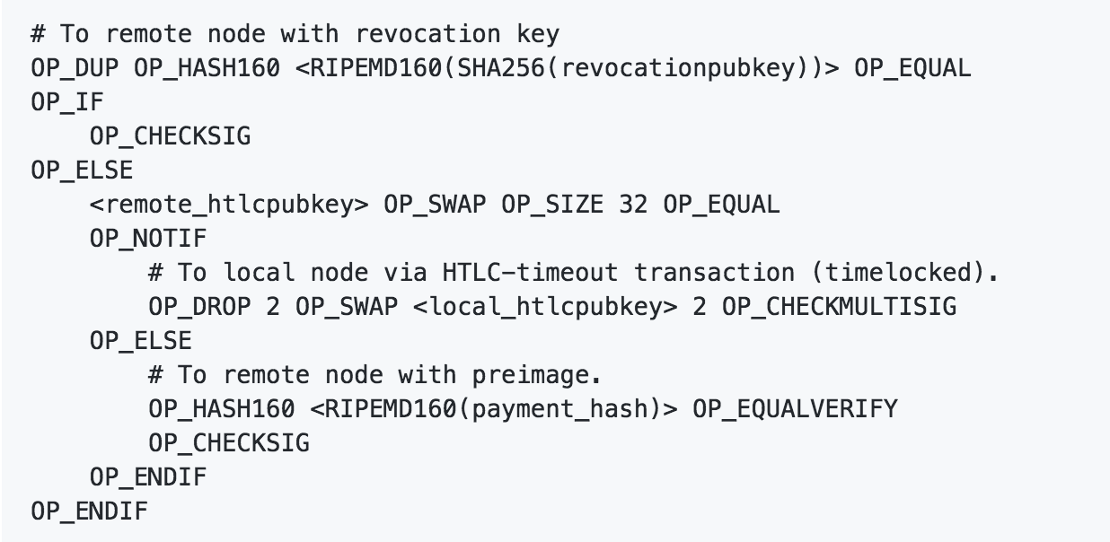
Offered HTLC outputs
B

Slide 65
Offered HTLC outputs
B

Slide 66
Offered HTLC outputs
B

Slide 67
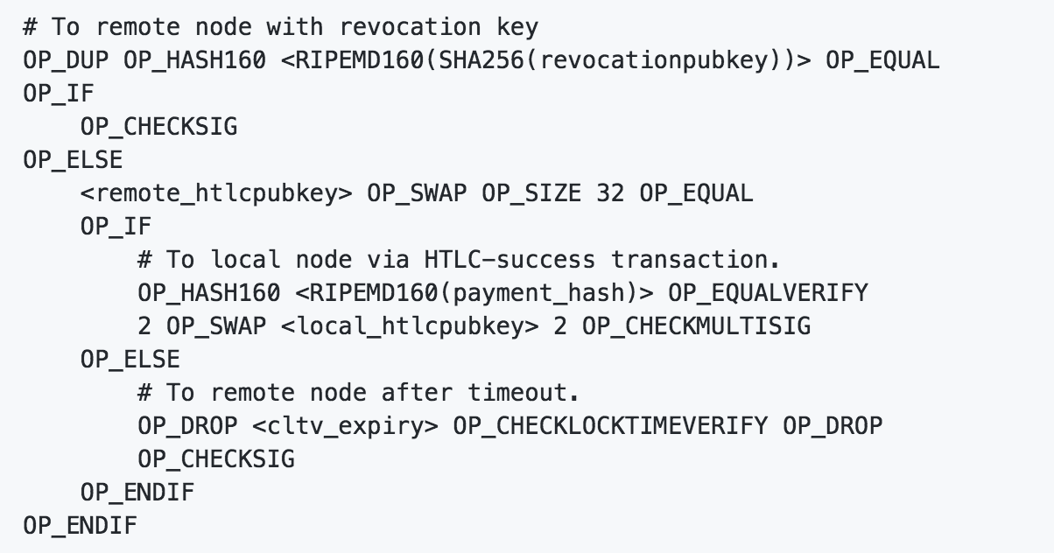
Received HTLC outputs for incomming HTLCs
B

Slide 68
HTLC-Timeout & HTLC Success Transactions
B

Slide 69
Key derivation (BOLT 03) for increased privacy
Each commitment tx uses a unique set of keys
localpubkey
remotepubkey
HTLCs use (based on per_commitment_point)
local_delaydpubkey
revocationpubkey
Reason ability to share as little information as possible with watching service
per_commitment_secret
revocation_base_point
delayed_payment_basepoint
Changing localpubkey / remotepubkey prevents guessing of commitment tx id
Regular / unilateral close should not be seen by the watching service
As well as the funding tx which also should not have been identified as such

Slide 70
Some properties of the key derivation
Deterministic way to generate secretes
In particular past secrets can be computed from current one
No need to store all previous revocation secrets
Revocation pubkeys are blinded
revocation_basepoint
remotes per_commitment_point
Technical details described in BOLT 03
https://github.com/lightningnetwork/lightning-rfc/blob/master/03-transactions.md#key-derivation

Slide 71
A trustless (Lightning) Network of payment channels
send
0.1 BTC to Charlie
Bob
0.65 BTC
channel A-B
channel B-C
Alice
0.35 BTC
Charlie
0.3 BTC
0.15 BTC
0.5 BTC
Some Hash H of R
0.35 BTC
0.3 BTC
2-2 Multisignature Wallet
0.5 BTC
2-2 Multisignature Wallet
0.8 BTC

Slide 72
A trustless (Lightning) Network of payment channels
send
0.1 BTC to Charlie
Bob
0.65 BTC
channel A-B
channel B-C
Alice
0.35 BTC
Charlie
0.3 BTC
0.15 BTC
0.5 BTC
Some Hash H of R
Some Hash H of R
0.35 BTC
0.3 BTC
2-2 Multisignature Wallet
0.5 BTC
2-2 Multisignature Wallet
0.8 BTC

Slide 73
A trustless (Lightning) Network of payment channels
I can't claim 0.1 BTC without knowing R (within some time)
If Bob doesn't provide R
I can soon claim back 0.1 BTC
Bob
0.65 BTC
channel A-B
channel B-C
Alice
0.25 BTC
Charlie
0.3 BTC
H
0.15 BTC
0.5 BTC
Some Hash H of R
0.1 BTC
0.25 BTC
0.3 BTC
2-2 Multisignature Wallet
0.5 BTC
2-2 Multisignature Wallet
0.8 BTC

Slide 74
A trustless (Lightning) Network of payment channels
I can't claim 0.1 BTC without providing R (within some time)
I pay charly if she can provide R (within some shorter time)
Bob
0.55 BTC
channel A-B
channel B-C
Alice
0.25 BTC
Charlie
0.3 BTC
H
H
0.15 BTC
0.4 BTC
Some Hash H of R
0.1 BTC
0.1 BTC
0.25 BTC
0.3 BTC
2-2 Multisignature Wallet
0.5 BTC
2-2 Multisignature Wallet
0.8 BTC

Slide 75
A trustless (Lightning) Network of payment channels
Tell Charlie R
Bob
0.65 BTC
channel A-B
channel B-C
Alice
0.25 BTC
Charlie
0.3 BTC
H
H
0.15 BTC
0.5 BTC
Some Hash H of R
0.1 BTC
0.1 BTC
0.25 BTC
0.3 BTC
R
2-2 Multisignature Wallet
0.5 BTC
2-2 Multisignature Wallet
0.8 BTC

Slide 76
Bob checks that R hashes to H
I can only claim 0.1 BTC by providing R to Bob
Bob
0.55 BTC
channel A-B
channel B-C
R
Alice
0.25 BTC
Charlie
0.4 BTC
H
0.15 BTC
0.4 BTC
Some Hash H of R
0.1 BTC
0.25 BTC
0.4 BTC
R
2-2 Multisignature Wallet
0.5 BTC
2-2 Multisignature Wallet
0.8 BTC

Slide 77
If successfully check
Great! Now I can also claim 0.1 BTC because I know R
Bob
0.55 BTC
channel A-B
channel B-C
R
Alice
0.25 BTC
Charlie
0.4 BTC
H
0.15 BTC
0.4 BTC
Some Hash H of R
0.1 BTC
0.25 BTC
0.4 BTC
R
2-2 Multisignature Wallet
0.5 BTC
2-2 Multisignature Wallet
0.8 BTC

Slide 78
Bob claims to settle htlc after releasing R
Bob must have payed Charlie otherwise he would not have known R.
I didn't need to trust him.
Bob
0.65 BTC
channel A-B
channel B-C
R
Alice
0.25 BTC
Charlie
0.4 BTC
R
0.25 BTC
0.4 BTC
Some Hash H of R
0.25 BTC
0.4 BTC
R
2-2 Multisignature Wallet
0.5 BTC
2-2 Multisignature Wallet
0.8 BTC

Slide 79
Source based Onion Routing - Sphinx Mix format
Setting up htlcs
(Chapter 4 / BOLT 04)

Slide 80
Why using the SPHINX mix Format?
Payer wants to be able to send money without being exposed
Payee doesn't want to be exposed
Routing nodes have to be able to send back an error message
Routing nodes should only know as little information about the payment as possible
Payment hash (will stop with payment decorrelation)
An upper bound for the amount (will stop with AMP)
Know incoming channel
Know outgoing channel
Routing nodes want to be able to verify the authenticity of the onion
HMAC checks at every hop
Research community will tell you
It's very compact - uses only little data
Better than slides: https://www.youtube.com/watch?v=toarjBSPFqI

Slide 81
Assuming enough capacity on all channels
Send 300 satoshis without direct payment channel
Alice
David
sid:
357
sid:
452
sid: 74
Bob
Carlie

Slide 82
Create onions starting from David (no payment hash)
Header
Version Byte
33 Byte compressed secp256k1 pubkey
Not the sender Pubkey (node_id / static key)
But an ephemeral pubkey from the sender for David!
Payload
1300 Hops_data
20 x 65 Bytes
1: realm (currently 0)
32 per_hop
32: HMAC
… filler
HMAC
32 Byte to verify the integrity

Slide 83
Per_hop data includes the amount and route info
Header
Version Byte
33 Byte compressed secp256k1 pubkey
Not the sender Pubkey (node_id / static key)
But a pubkey from the sender for David!
Payload
1300 Hops_data
20 x 65 Bytes
1: realm (currently 0)
32 per_hop
32: HMAC
… filler
HMAC
32 Byte to verify the integrity
8: short_channel_id
8: amt_to_forward
4: outgoing_cltv_value
12: padding (for backwards compatibility)

Slide 84
Per_hop payload for david (simplified!)
Send 300 satoshis without direct payment channel
Alice
David
8: amt_to_forward
8: short_channel_id
4:outgoing_cltv_value
sid:
357
0
300
9
sid:
452
sid: 74
Bob
Carlie

Slide 85
Onion for David (without HMAC and filler)
Send 300 satoshis without direct payment channel
Alice
David
8: amt_to_forward
8: short_channel_id
4:outgoing_cltv_value
sid:
357
0
300
9
sid:
452
Ek D
u3h4kj23048yerg2j3r
sid: 74
Bob
Carlie

Slide 86
Payload for Charlie (Simplified)
Send 300 satoshis without direct payment channel
Alice
David
8: amt_to_forward
8: short_channel_id
4:outgoing_cltv_value
sid:
357
0
300
9
sid:
452
452
300
18
Ek D
u3h4kj23048yerg2j3r
sid: 74
Bob
Carlie

Slide 87
Onion for Charly (without HMAC and filler)
Send 300 satoshis without direct payment channel
Alice
David
8: amt_to_forward
8: short_channel_id
4:outgoing_cltv_value
sid:
357
0
300
9
sid:
452
452
300
18
Ek D
u3h4kj23048yerg2j3r
Ek C
aksjhdflka813r83n09aw0923kjqk34jt2kjt3jhk2jh3tqkjw
sid: 74
Bob
Carlie

Slide 88
Payload for Bob (simplified)
Send 300 satoshis without direct payment channel
Alice
David
8: amt_to_forward
8: short_channel_id
4:outgoing_cltv_value
sid:
357
0
300
9
sid:
452
452
300
18
Ek D
u3h4kj23048yerg2j3r
74
301
41
Ek C
aksjhdflka813r83n09aw0923kjqk34jt2kjt3jhk2jh3tqkjw
sid: 74
Bob
Carlie

Slide 89
Onion for Bob without HMAC and filler
Send 300 satoshis without direct payment channel
Alice
David
8: amt_to_forward
8: short_channel_id
4:outgoing_cltv_value
sid:
357
0
300
9
sid:
452
452
300
18
Ek D
u3h4kj23048yerg2j3r
74
301
41
Ek C
aksjhdflka813r83n09aw0923kjqk34jt2kjt3jhk2jh3tqkjw
Ek B
374yiu3h4ot8h2no2iht2htp82hts98dfgoh2408h2048gh2084ghh2g0240gh24hg082h4g-
sid: 74
Bob
Carlie

Slide 90
Some notes on the presented simplifications
The onions themselfs are the payload of the update_add_htlc message
Described later in the peer protocol
The message contains the payment hash
The message offers an htlc with an actual amount
Usually nodes offer the amount that they are supposed to forward
Alice constructs the onion and uses ephemeral keys for every hop
Onions are encrypted with a Diffie-Helmann shared secret between
Hops ephemeral key (generated by Alice)
Hops node_id (static key)
Onions are always 1366 bytes in length
Even if it is the last hop
The onions are padded with junk data
Padding process left out but described in BOLT 04
This prevents a routing node to guess its position in the route by the length of the onion

Slide 91
Transport Layer - The Noise Protocol Framework
(Chapter 5 / BOLT 08)

Slide 92
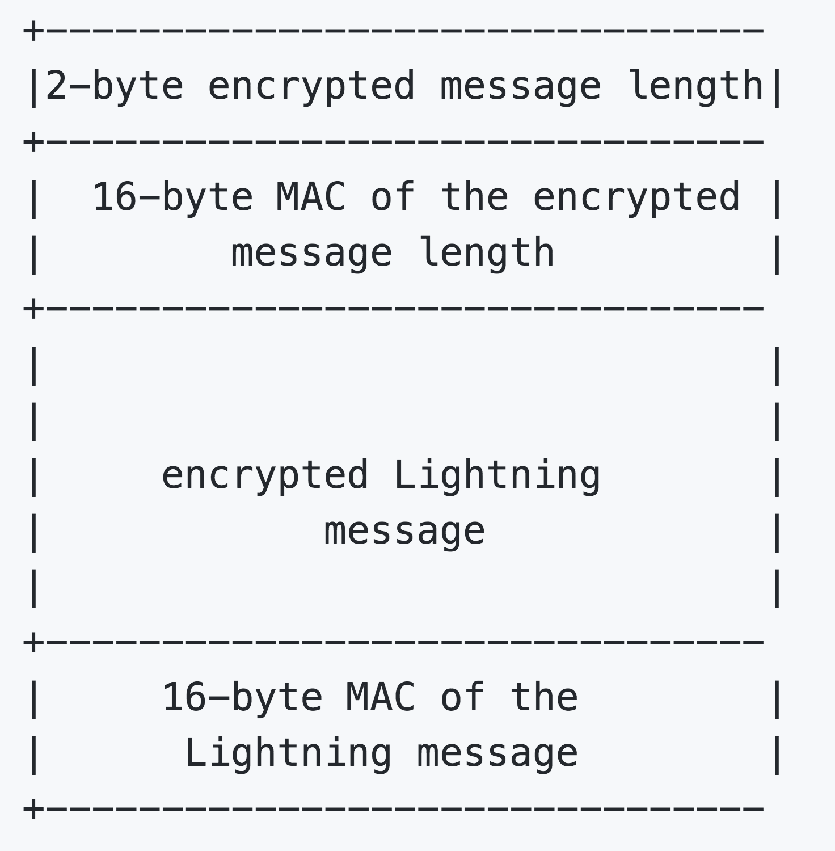
Communication is encrypted and authenticated
Communication is done by messages between peers
Messages are sent in a session
Encrypted
And authenticated with a 16 Byte MAC
Messages are prepended with a header
The header contains the message length
The header is encrypted
The header is also authenticated with a MAC
MAC makes messages safe against malicious interference
Encryption makes messages private

Slide 93
Lightning uses the Noise Protocol Framework
2 phases
Handshake phase
Exchange of DH public keys, hashing, creating a session key
Transport phase
Shared key will be used to send encrypted messages
Noise Protocol Framework can create 12 fundamental handshake patterns
Sender
N - No static key for initiator
K - static for initiator known to responder
X - Static key for initiator xmitted (transmitted) to responder
I - Static key for initiator immediately transmitted to responder
Responder
N - No static key for Transponder
K - Static key for responder known to initiator
X - Static key for responder xmitted to initiator

Slide 94
Lightning Network uses the Noise XK pattern
X - Static key for initiator xmitted (transmitted) to responder
K - Static key for responder known to initiator
XK:
< -- s
…
--> e, es (act 1: send ephemeral key to responder)
<-- e, ee (act 2 send responders ephemeral key to sender)
--> s, se (act 3 authenticate sender)

Slide 95
Payload security properties achieved by XK
Sender authentication resistant to key-compromise impersonation (KCI).
The sender authentication is based on an ephemeral-static DH ("es" or "se") between the
sender's static key pair and
the recipient's ephemeral key pair.
Assuming the corresponding private keys are secure, this authentication cannot be forged.
Encryption to a known recipient, strong forward secrecy.
This payload is encrypted based on
an ephemeral-ephemeral DH as well as
an ephemeral-static DH with the recipient's static key pair.
This payload cannot be decrypted assuming
the ephemeral private keys are secure,
and the recipient is not being actively impersonated by an attacker that has stolen its static private key

Slide 96
Identity hiding properties achieved by XK
Initiator
Encrypted with forward secrecy to an authenticated party
Responder
Not transmitted,
Passive attacker can check candidates for the responder's private key
and determine whether the candidate is correct.
An attacker could also replay a previously-recorded message to a new responder
determine whether the two responders are the "same"
(i.e. are using the same static key pair)
Does the recipient accept the replay message?
Warning! Identities may be exposed through other means including:
Payload fields
Traffic analysis
Metadata such as IP addresses

Slide 97
Key setup for the Transport layer
Each Lightning Network node is identified by a static node_id (pubkey)
Curvepoint on secp256k1 curve which is also used in bitcoin
Private key is derived from a mnemonic seed
The Transport layer uses ephemeral session keys before actual data transfer
Authenticated key agreement handshake
Based on the Noise Protocol Framework
Whatsapp, WireGuard, I2P
http://noiseprotocol.org/noise.html
Message exchange phase
Authenticated encryption with associated data (AEAD) cyphertexts
Key rotation after a key is used 1000 times
I.e. every 500 messages
Each messages goes through 2 separate but identical encryption processes

Slide 98
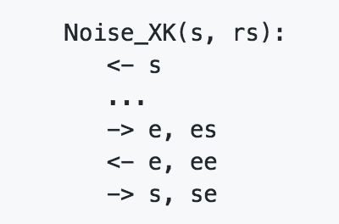
Authenticated Key Agreement Handshake
Following the noise framework e and s are public keys
s is the node_id (also called the static key)
e is an ephemeral key used to for setting up the cryptographic session
ee, es, se, ss are a notation for a Diffie Hellman Key exchange in which
The first letter is the key from the local side
The second letter is the key from the remote side
Attention!
Can be confusing when sending messages from responder to initiator

Slide 99
Processing of handshake data
Handshake data including keying materials is hashed into a session-wide "handshake-digest" h
h is never transmitted during the handshake
h is used as a MAC in the AEAD messages
If a MAC check fails during the handshake process the connection is immediately terminated
Privacy Risk:
Man in the middle could disturb operations by making handshakes fail all the time
User might be tricked to upgrade the node
Potentially like the electrum phishing hack from a malicious source

Slide 100
Handshake State
Each side maintains these variables
Chaining key: ck
Handshake key: h
Ephemeral key: e
Static keypair: s (ls for local, rs for remote) usually the node_id is taken
Functions to be used
ECDH(k,rk) with k is a privatekey and rk is a curvepoint.
Elliptic curve Diffie Hellman
Return is the SHA256 of the DER-compressed format of the generated point
HKDF(salt, ikm)
HMAC-based Extract-and-Expand Key Derivation Function (HKDF)
https://tools.ietf.org/html/rfc5869
ChaCha20-Poly1305 (IETF Variant)
encrypt(k, n, ad, plaintext)
decrypt(k,n, ad, ciphertext)

Slide 101
Noise protocol instantiation
Noise Protocol Framework needs three cryptographic functions
Hashfunction: SHA-256
Elliptic curve: secp256k1
AEAD: ChaChaPoly-1305 as the composion of ChaCha20 and Poly1305
Specified in https://tools.ietf.org/html/rfc7539
Official Name:
Noise_XK_secp256k1_ChaChaPoly_SHA256
Hash of official name is hashed to a digest to initialize the starting handshake state:
h = 0x2640f52eebcd9e882958951c794250eedb28002c05d7dc2ea0f195406042caf1
ck = h
h = sha( h || "lightning" )

Slide 102
Noise protocol setup: Act 1 --> e, es (50 bytes)
e = genKey()
h = SHA-256(h || e.pub.serialize())
es = ECDH(e.priv, rs)
ck,tmp_k1 = HKDF(ck, es)
c = encrypt(tmp_k1,0,h,"")
h = SHA-256(h || c)
Send m =0 || e.pub.serialize() || c

Slide 103
Noise protocol setup: Act 1 --> e, es (50 bytes)
e = genKey()
h = SHA-256(h || e.pub.serialize())
es = ECDH(e.priv, rs)
ck,tmp_k1 = HKDF(ck, es)
c = encrypt(tmp_k1,0,h,"")
h = SHA-256(h || c)
Send m =0 || e.pub.serialize() || c
v, re, c = read(m)
h = SHA-256(h || re.serialize())
es = ECDH(s.priv, re)
ck, tmp_k1 = HKDF(ck, es)
p = decrypt(tmp_k1, 0, h, c)
h = SHA-256(h || c)
Important! MAC check in decrypt. This allows us to know the authenticity of the ephemeral key e.

Slide 104
Remember senders e and receivers re are the same
e = genKey()
h = SHA-256(h || e.pub.serialize())
es = ECDH(e.priv, rs)
ck,tmp_k1 = HKDF(ck, es)
c = encrypt(tmp_k1,0,h,"")
h = SHA-256(h || c)
Send m =0 || e.pub.serialize() || c
v, re, c = read(m)
h = SHA-256(h || re.serialize())
es = ECDH(s.priv, re)
ck, tmp_k1 = HKDF(ck, es)
p = decrypt(tmp_k1, 0, h, c)
h = SHA-256(h || c)
Important! MAC check in decrypt. This allows us to know the authenticity of the ephemeral key e.

Slide 105
That is exactly the DH-Key exchange
e = genKey()
h = SHA-256(h || e.pub.serialize())
es = ECDH(e.priv, rs)
ck,tmp_k1 = HKDF(ck, es)
c = encrypt(tmp_k1,0,h,"")
h = SHA-256(h || c)
Send m =0 || e.pub.serialize() || c
v, re, c = read(m)
h = SHA-256(h || re.serialize())
es = ECDH(s.priv, re)
ck, tmp_k1 = HKDF(ck, es)
p = decrypt(tmp_k1, 0, h, c)
h = SHA-256(h || c)
Important! MAC check in decrypt. This allows us to know the authenticity of the ephemeral key e.

Slide 106
Noise protocol setup: Act 2 <-- e, ee (50 bytes)
e = genKey()
H = SHA-256(h || e.pub.serialize())
ee = ECDH(e.priv, re)
ck,tmp_k2 = HKDF(ck, ee)
c = encrypt(tmp_k2,0,h,"")
h = SHA-256(h || c)
Send m =0 || e.pub.serialize() || c

Slide 107
Noise protocol setup: Act 2 <-- e, ee (50 bytes)
v, re, c = read(m)
h = SHA-256(h || re.serialize())
ee = ECDH(e.priv, re)
ck, tmp_k2 = HKDF(ck, ee)
p = decrypt(tmp_k2, 0, h, c)
h = SHA-256(h || c)
Important! MAC check in decrypt. This allows us to know the authenticity of the ephemeral key of the responder e.
e = genKey()
H = SHA-256(h || e.pub.serialize())
ee = ECDH(e.priv, re)
ck,tmp_k2 = HKDF(ck, ee)
c = encrypt(tmp_k2,0,h,"")
h = SHA-256(h || c)
Send m =0 || e.pub.serialize() || c

Slide 108
Pay attention to the notation of e, re and ee
v, re, c = read(m)
h = SHA-256(h || re.serialize())
ee = ECDH(e.priv, re)
ck, tmp_k2 = HKDF(ck, ee)
p = decrypt(tmp_k2, 0, h, c)
h = SHA-256(h || c)
Important! MAC check in decrypt. This allows us to know the authenticity of the ephemeral key of the responder e.
e = genKey()
H = SHA-256(h || e.pub.serialize())
ee = ECDH(e.priv, re)
ck,tmp_k2 = HKDF(ck, ee)
c = encrypt(tmp_k2,0,h,"")
h = SHA-256(h || c)
Send m =0 || e.pub.serialize() || c

Slide 109
Noise protocol setup: Act 3 --> s, se (66 bytes)
c = encrypt(tmp_k2, 1, h, s.pub.serialize())
h = SHA-256(h || c)
se = ECDH(s.priv, re)
ck,tmp_k3 = HKDF(ck, se)
t = encrypt(temp_k3, 0, h, "")
sk,rk = HKDF(ck, "")
c = encrypt(tmp_k1, 0, h, "")
rn = 0, sn = 0
Send m =0 || c || t

Slide 110
Noise protocol setup: Act 3 --> s, se (66 bytes)
v, c, t = read(m)
rs = decrypt(tmp_k2, 1, h, c)
h = SHA-256(h || c)
se = ECDH(e.priv, rs)
ck, tmp_k3 = HKDF(ck, se)
p = decrypt(tmp_k3, 0, h, t)
rk, sk = HKDF(ck, se)
rn = 0, sn = 0
c = encrypt(tmp_k2, 1, h, s.pub.serialize())
h = SHA-256(h || c)
se = ECDH(s.priv, re)
ck,tmp_k3 = HKDF(ck, se)
t = encrypt(temp_k3, 0, h, "")
sk,rk = HKDF(ck, "")
c = encrypt(tmp_k1, 0, h, "")
rn = 0, sn = 0
Send m =0 || c || t

Slide 111
Encrypting Messages
Message m with sendingkey sk and nonce sn
l = len(m)
Serialize l into 2 byte big-endian integer
Encrypt l (using ChaChaPoly-1305, sn, sk) to obtain HMAC lc
sn = sn + 1
Encrypt m in the same way to receive ciphertext c
sn = sn + 1
Send lc || c

Slide 112
Decrypting Messages
Read exactly 18 bytes header as lc
Decrypt lc (using ChaCha20-Poly1305, rn, rk)
Obtain size l
Check HMAC
Increment nonce rn
Read exactly 16 + l bytes as c
Decrypt c (using ChaCha20-Poly1305, rn, rk) to obtain plaintext p
Increase nonce rn

Slide 113
Lightning Message Key Rotation
Keys should be rotated regular basis
Every message uses a key twice
Keys are rotated after being used 1000 times
So every 500 messages
k is the sk or rk
ck from the end of ACT 3
ck', k' = HKDF(ck, k)
Reset the nonce for k to n = 0
k = k'
ck = ck'
Using ping and pong messages helps rotating keys more quickly

Slide 114
Messaging / Peer Protocol
(Chapter 6 / BOLT 01 / BOLT 02)

Slide 115
Purpose of the Peer Protocol
Establish communication between two peers that are connected
Assumes a working authenticated and encrypted Transport Layer
(on top of a single TCP socket)
How will two nodes be able to maintain a RSMC (and HTLCs)?
How will onion packages be sent between peers?
Channel Management and operation of the channel
Channel establishment
Channel close
Normal Operation
Sending, accepting and forwarding payments
Updating fees
Message Retransmission (as communication transports are unreliable)

Slide 116
Format of Lightning messages
2 byte type field (big endian)
Variable length payload
Max: 65535 Byte
Format of the payload confirms to the type
Even typed messages MUST be specified and MUST NOT be sent otherwise
It's ok to be odd
Logical groups of types
0 - 31 Setup & Control
32-127 Channel establishment and closure
128-255 channel operation including setup and settlement of htlcs
256-511 gossip protocol

Slide 117
The init message
First message after setup of the Transport layer
Resent after reconnection
MUST be the first lightning message
Shares information about supported / deprecated features
See BOLT 09
Features allow for upgrading the protocol
Local features are relevant for the channel
Global features are relevant for the network
Type 16:
Data
2: gflen
gflen: globalfeatures
2: lflen
lflen: localfeatures

Slide 118
The error message
Usually not exposed to userland
Type 17:
Data
32: channel_id
Before funding_created it is the temporary_channel_id
2: len
len: data
lflen: localfeatures

Slide 119
The ping and pong messages
Type 18: (ping)
Data:
2: num_pong_bytes
2: byteslen
byteslen: ignored
Type 19: (pong)
Data:
2: byteslen
byteslen: ignored
Nodes MUST NOT use sensitive data in ping & pong messages
Synthetic traffic to fake activity to defend against packet & timing analysis
Leads to frequent key rotation of the transport layer (every 500 messages)

Slide 120
Establishing a channel
(Chapter 6a / BOLT 02)

Slide 121
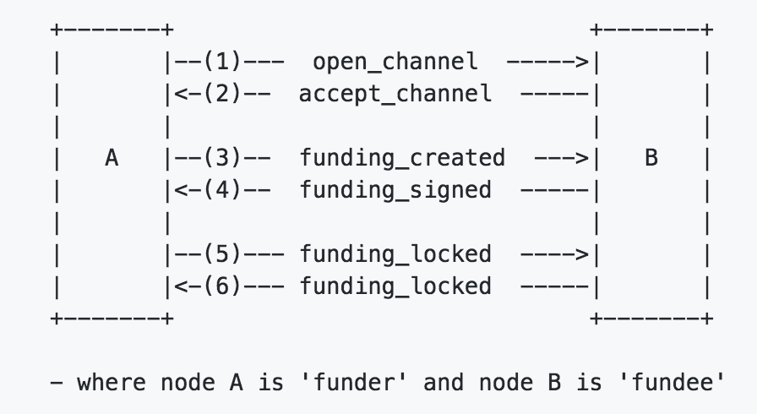
Establishing a channel
Initializing and authenticating a peer connection
5 messages
open_channel
Suggests a channel with certain parameters
accept_channel
Aggrees to the channel
funding_created
Sends its signature for first commitment tx
funding_signed
Sends 2nd sig for commitment tx
funding_locked
Sends next_per_commitment_point (if funding tx has enough confirmations)

Slide 122
The open_channel message (type 32) ---->
32: chain_hash
32: temporary_channel_id
8: funding_satoshis
8: push_msat
8: dust_limit_satoshis
8: max_htlc_value_in_flight_msat
8: htlc_minimum_msat
2: to_self_delay
2: max_accepted_htlcs
33: funding_pubkey
Basepoints (as in BOLT 03 for privacy reason with watchtowers)
33: Revocation
33: Payment
33: Delayed_payment
33: Htlc
33: first_per _commitment
1: channel_flags, 2: shutdown_len, shutdown_scriptpubkeyv

Slide 123
The accept_channel message (type 33) <----
32: temporary_channel_id
8: dust_limit_satoshis
8: max_htlc_value_in_flight_msat
8: channel_reserve_satoshis
8: htlc_minimum_msat
4: minimum_depth
2: to_self_delay
2: max_accepted_htlcs
33: funding_pubkey
Basepoints (as in BOLT 03 for privacy reason with watchtowers)
33: Revocation
33: Payment
33: Delayed_payment
33: Htlc
33: first_per _commitment
2: shutdown_len, shutdown_scriptpubkey

Slide 124
The funding_created message (type 34) ---->
32: temporary_channel_id
MUST be same as in open channel message
32: funding_txid
Tx has to be non malleable and MUST NOT be broadcasted at that time
2: funding_output_index
64: signature
Valid signature using the funding_pubkey for the initial commitment tx
If incorrect channel MUST be failed

Slide 125
The funding_signed message <----
32: channel_id
Funding_txid ^ funding_output_index
64: signature
2nd signature for the first commitment tx
If invalid
fail channel
MUST NOT broadcast the funding_tx
If valid SHOULD broadcast the funding_tx

Slide 126
On Transaction Malleability and the need for segWit
After signatures for commitment tx are exchanged via funding_signed
Funding tx is published by A
B can catch this funding tx
If B malleates the tx it gets a new txid
Ways to malleate the tx via
Signature
sigScript
https://en.bitcoin.it/wiki/Transaction_malleability
B can try to publish the malleated version
Commitment tx refers to txid
If txid of funding tx is malleated the commitment tx becomes worthless
B can now blackmail A
A cannot access the funds A provided without the help of B
Since B did not invest some funds this way for blackmail is "cost free" for B
Segwit mitigates the possibility to malleate a transaction

Slide 127
The funding_locked message (type 36) ----> <----
32: channel_id
33: next_per_commitment_point
As defined in BOLT 03 Key derivation
Used for next commitment transaction
Yes every commitment transaction uses a different basepoint
Future base points cannot be derived from old ones
This shall improve the privacy
Especially when using watching services
Funding_locked message is necessary for the channel to become operational
Sender MUST wait until minimum_depth of funding tx before sending this message
Recipient SHOULD forget the channel if message does not come
Mitigates DoS attack risks.

Slide 128
Closing a channel
(Chapter 6b / BOLT 02 / BOLT 05)

Slide 129
3 ways for closing a channel (BOLT 05)
The good (Mutual close)
1 closing transaction
Similar to commitment tx but no pending payments
Part of BOLT 02 - peer protocol
The bad (unilateral close)
The protocol was breached
Look out for "... MUST fail the channel" in the BOLTs
Could be accidentally e.g. hardware failure
One side publishes latest commitment transaction
Part of BOLT 05 - onchain
The ugly (revoked transaction close)
One party (deliberately?) tries to cheat
Software bugs
Part of BOLT 05 - onchain

Slide 130
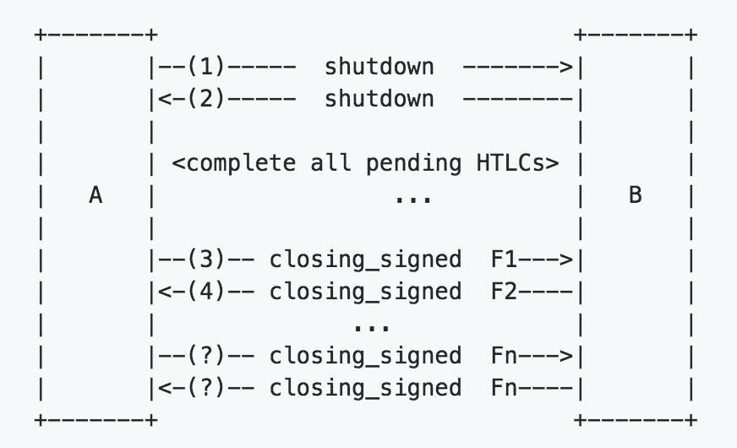
The good way - Mutual Close (always preferable)
Excludes the time lock of the funds
Partners can spend the funds directly
Fee can be negotiated when closing takes place
Potentially saves fee
2 Messages are included
shutdown
To signal intend
closing_signed
Mainly to negotiate fees

Slide 131
The shutdown message
Type: 38
Data
32: channel_id
2: len
len: scriptpubkey (one of the following script templates)
P2PKH: OP_DUP OP_HASH160 20 20-bytes OP_EQUALVERIFY OP_CHECKSIG
P2SH: OP_HASH160 20 20-bytes OP_EQUAL
P2WPKH: OP_0 20 20-bytes
P2WSH: OP_0 32 32-bytes
MUST NOT be before funding_created / funding_signed messages
MAY be done before funding_locked messages
No future add_update_htlc messages will be accepted
No future update messages will be accepted

Slide 132
The closing_signed message
Type: 39
Data
32: channel_id
8: fee_satoshis
64: signature
All htlcs must be settled / cleared in the current Commitment Tx
If fees of one roundtrip of closing_signed message are equal
SHOULD sign and broadcast the closing tx
MAY close the connection
Fee_satoshis should converge
MUST propose a value strictly between received fee_satoshis and previously-sent one.
No real risk for DOS as channel partner could fail the channel

Slide 133
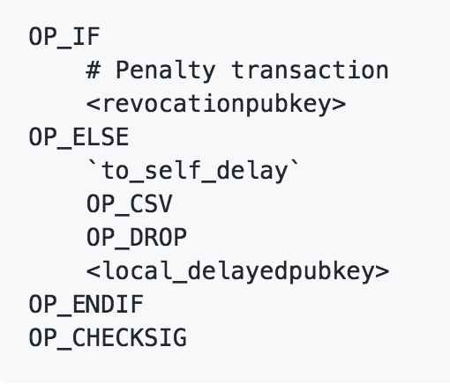
The bad way - Unilateral / Force Close
The most recent commitment transaction is pushed to the chain
Channel stops immediately to be operational
Almost exact channel state is seen on chain
Balance
All fully committed htlcs in flight whose outputs are higher than dust
Including preimages
Spend htlcs with either
Htlc - success transactions (assuming knowledge of the preimage)
Htlc - timeout transactions

Slide 134
The ugly way - Revoked Transaction Close
An old commitment transaction was published
Revocation secrets have been shared via revoke_and_ack message
We see how in the following 'normal channel operation' part
Other side claims all funds within a time lock
This is the penalty mechanism that incentivises both parties to be honest and not go for the ugly way
For the mechanism to work there should always be a channel reserve on channels so that there is actually some penalty to collect.
A watching service can help to do so
If no claiming with the time lock the breaching party can spend their outputs
This case should never ocurr

Slide 135
Normal operation of a channel
(Chapter 6c / BOLT 02)

Slide 136
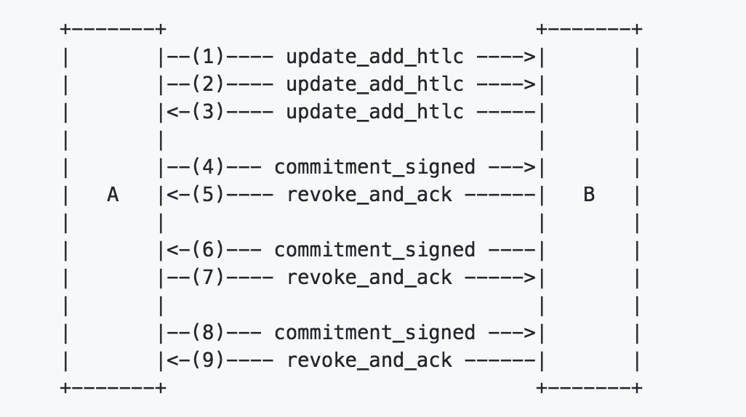
3 messages are necessary to operate a channel
(Chapter 7c / BOLT 02)

Slide 137
The 5 stages for a htlc to become valid
Alice wants to offer a payment to Bob of 15 mBTC
Pending on the receiver
In the receivers latest commitment tx
Receivers old commitment tx is revoked, update is pending at the sender
In the senders latest commitment tx
Senders old commitment tx is revoked

Slide 138
The 5 stages for a htlc to become valid
Alice wants to offer a payment to Bob of 15 mBTC
Commitment Transaction 2a (Alice)
Commitment Transaction 2b (Bob)
Input (100 mBTC)
Input (100 mBTC)
Output 0
(20 mBTC)
Bob's Key
Output 1
(80 mBTC)
RSMC
Output 0
(80 mBTC)
Alice's Key
Output 1
(20 mBTC)
RSMC

Slide 139
Alice sends an update_add_htlc message to Bob
Commitment Transaction 2a (Alice)
Commitment Transaction 2b (Bob)
Input (100 mBTC)
Input (100 mBTC)
Output 0
(20 mBTC)
Bob's Key
Output 1
(80 mBTC)
RSMC
unsigned
Output 0
(80 mBTC)
Alice's Key
Output 1
(20 mBTC)
RSMC
Commitment Transaction 3b (Bob)
Input (100 mBTC)
Output 0
(65 mBTC)
Alice's Key
Output 1
(20 mBTC)
RSMC
Output 2
(15 mBTC)
HTLC

Slide 140
2. Alice sends a commitment_signed message to Bob
Commitment Transaction 2a (Alice)
Commitment Transaction 2b (Bob)
Input (100 mBTC)
Input (100 mBTC)
Output 0
(20 mBTC)
Bob's Key
Output 1
(80 mBTC)
RSMC
Output 0
(80 mBTC)
Alice's Key
Output 1
(20 mBTC)
RSMC
Commitment Transaction 3b (Bob)
Input (100 mBTC)
Output 0
(65 mBTC)
Alice's Key
Output 1
(20 mBTC)
RSMC
Output 2
(15 mBTC)
HTLC

Slide 141
3. Bob sends a revoke_and_ack message to Alice
Commitment Transaction 2a (Alice)
Commitment Transaction 2b (Bob)
Input (100 mBTC)
Input (100 mBTC)
revoked
Output 0
(20 mBTC)
Bob's Key
Output 1
(80 mBTC)
RSMC
unsigned
Output 0
(80 mBTC)
Alice's Key
Output 1
(20 mBTC)
RSMC
Commitment Transaction 3a (Alice)
Commitment Transaction 3b (Bob)
Input (100 mBTC)
Input (100 mBTC)
Output 0
(20 mBTC)
Bob's Key
Output 1
(65 mBTC)
RSMC
Output 2
(15 mBTC)
HTLC
Output 0
(65 mBTC)
Alice's Key
Output 1
(20 mBTC)
RSMC
Output 2
(15 mBTC)
HTLC

Slide 142
4. Bob sends a commitment_signed message to Alice
Commitment Transaction 2a (Alice)
Commitment Transaction 2b (Bob)
Input (100 mBTC)
Input (100 mBTC)
revoked
Output 0
(20 mBTC)
Bob's Key
Output 1
(80 mBTC)
RSMC
Output 0
(80 mBTC)
Alice's Key
Output 1
(20 mBTC)
RSMC
Commitment Transaction 3a (Alice)
Commitment Transaction 3b (Bob)
Input (100 mBTC)
Input (100 mBTC)
Output 0
(20 mBTC)
Bob's Key
Output 1
(65 mBTC)
RSMC
Output 2
(15 mBTC)
HTLC
Output 0
(65 mBTC)
Alice's Key
Output 1
(20 mBTC)
RSMC
Output 2
(15 mBTC)
HTLC

Slide 143
5. Alice sends a revoke_and_ack message to Bob
Commitment Transaction 2a (Alice)
Commitment Transaction 2b (Bob)
Input (100 mBTC)
Input (100 mBTC)
revoked
Output 0
(20 mBTC)
Bob's Key
Output 1
(80 mBTC)
RSMC
Output 0
(80 mBTC)
Alice's Key
Output 1
(20 mBTC)
RSMC
Commitment Transaction 3a (Alice)
Commitment Transaction 3b (Bob)
Input (100 mBTC)
Input (100 mBTC)
Output 0
(20 mBTC)
Bob's Key
Output 1
(65 mBTC)
RSMC
Output 2
(15 mBTC)
HTLC
Output 0
(65 mBTC)
Alice's Key
Output 1
(20 mBTC)
RSMC
Output 2
(15 mBTC)
HTLC

Slide 144
Only now Bob SHOULD forward the htlc!
Commitment Transaction 2a (Alice)
Commitment Transaction 2b (Bob)
Input (100 mBTC)
Input (100 mBTC)
revoked
Output 0
(20 mBTC)
Bob's Key
Output 1
(80 mBTC)
RSMC
Output 0
(80 mBTC)
Alice's Key
Output 1
(20 mBTC)
RSMC
Commitment Transaction 3a (Alice)
Commitment Transaction 3b (Bob)
Input (100 mBTC)
Input (100 mBTC)
Output 0
(20 mBTC)
Bob's Key
Output 1
(65 mBTC)
RSMC
Output 2
(15 mBTC)
HTLC
Output 0
(65 mBTC)
Alice's Key
Output 1
(20 mBTC)
RSMC
Output 2
(15 mBTC)
HTLC

Slide 145
The update_add_htlc offers a htlc to another node
Type: 128
Data
32: channel_id
8: id
Htlcs are building a sequence of channel states MUST increment by one
8: amount_msat
Amount offered
32: payment_hash
As given in the invoice and used in the htlc scripts
4: cltv_expiry
Timelock should fit channel parameters and relate to the path for routing
1366: onion_routing_packet
Always has this size
Is even needed in the case of the last node
Contains a session key for DH and HMAC
Includes no signature (Remember Transport has strong authentication)

Slide 146
The commitment_signed message
Type: 132
Data:
32: channel_id
64: signature
For the other side to be used and verified to sign the commitment tx
2: num_htlcs
num_htlcs*64: htlc_signatures
Each htlcs should have a different payment hash
Basepoint changed for each commitment tx
Thus signatures change

Slide 147
The revoke_and_ack message
Type: 133
Data
32: channel_id
32: per_commitment_secret
MUST generate the current (previous) per_commitment_point
SHOULD be generated following the key derivation protocol (BOLT 03)
Otherwise node MAY fail channel
Compact / efficient key storage
Acts as revocation key
32: next_per_commitment_point

Slide 148
4 reasons for removing an htlc
Payment preimage is being supplied
update_fulfill _htlc
Htlc is timeouted
update_fail_htlc
Htlc failed to route (at a later node of the path)
update_fail_htlc
Malformed
update_fail_malformed_htlc
Only a node that received an htlc can remove it
For simplicity

Slide 149
The update_fullfil_htlc message
Type: 130
Data:
32: channel_id
8: id
32: payment_preimage
Obviously the payment_preimage MUST hash to the payment hash
The next commitment tx can leave this htlc out
Including it would only waste space
Commitment tx are not explicitly updated at this point

Slide 150
The update_fail_htlc message
Type: 131
Data:
32: channel_id
8: id
2: len
Len: reason
The SPHINX mix format allows for nodes to send back an error to the unknown initiator of the message
The reason is only be readable by the initiator of the payment
The initiator can't expect a failure message
In intermediate connection could break done before the error message is sent

Slide 151
The update_fail_malformed_htlc
Sent if the onion is not parsable
Type: 135
Data:
32: channel_id
8: id
32: sha256_of_onion
2: failure_code
As defined in BOLT 04

Slide 152
Rational for Retransmission messages
Communication transports are unreliable
Cannot be assumed updates_add_htlc were received unless commitment_signed was received
Only store updates upon receipt of commitment_signed
This ensures retransmission after channel_reestablishment
Type: 136 (channel_reestablish)
Data:
32: channel_id
8: next_local_commitment_number
8: next_remote_revocation_number
32: your_last_per_commitment_secret
32: my_current_per_commitment_point

Slide 153
Workflow of a Payment starts with a BOLT 11 invoice
Payment Hash
R → H(R)
H(R)
Bolt 11 Invoice
Alice
David

Slide 154
After receiving the invoice Alice selects a path to David
Payment Hash
R → H(R)
H(R)
Bolt 11 Invoice
Alice
Find a path (for example via Bob and Charlie)
David
Alice
Bob
Charlie
David

Slide 155
Alice creates the Onion package (starting from David)
Payment Hash
R → H(R)
H(R)
Bolt 11 Invoice
Alice
Find a path (for example via Bob and Charlie)
David
Alice
Bob
Charlie
David
0
300
9
Alice creates Onion package
452
300
18
Ek D
u3h4kj23048yerg2j3r
74
301
41
Ek C
aksjhdflka813r83n09aw0923kjqk34jt2kjt3jhk2jh3tqkjw
Ek B
374yiu3h4ot8h2no2iht2htp82hts98dfgoh2408h2048gh2084ghh2g0240gh24hg082h4g

Slide 156
Alice offers the first htlc to Bob
Payment Hash
R → H(R)
H(R)
Bolt 11 Invoice
Alice
Find a path (for example via Bob and Charlie)
David
Alice
Bob
Charlie
David
0
300
9
Alice creates Onion package
452
300
18
Ek D
u3h4kj23048yerg2j3r
74
301
41
Ek C
aksjhdflka813r83n09aw0923kjqk34jt2kjt3jhk2jh3tqkjw
Ek B
374yiu3h4ot8h2no2iht2htp82hts98dfgoh2408h2048gh2084ghh2g0240gh24hg082h4g
HTLC
update_add_htlc

Slide 157
Bob processes the onion and offers an htlc to Charlie
Payment Hash
R → H(R)
H(R)
Bolt 11 Invoice
Alice
Find a path (for example via Bob and Charlie)
David
Alice
Bob
Charlie
David
0
300
9
Alice creates Onion package
452
300
18
Ek D
u3h4kj23048yerg2j3r
74
301
41
Ek C
aksjhdflka813r83n09aw0923kjqk34jt2kjt3jhk2jh3tqkjw
Ek B
374yiu3h4ot8h2no2iht2htp82hts98dfgoh2408h2048gh2084ghh2g0240gh24hg082h4g
HTLC
update_add_htlc
HTLC
update_add_htlc

Slide 158
Charlie processes the onion and offers htlc to David
Payment Hash
R → H(R)
H(R)
Bolt 11 Invoice
Alice
Find a path (for example via Bob and Charlie)
David
Alice
Bob
Charlie
David
0
300
9
Alice creates Onion package
452
300
18
Ek D
u3h4kj23048yerg2j3r
74
301
41
Ek C
aksjhdflka813r83n09aw0923kjqk34jt2kjt3jhk2jh3tqkjw
Ek B
374yiu3h4ot8h2no2iht2htp82hts98dfgoh2408h2048gh2084ghh2g0240gh24hg082h4g
HTLC
update_add_htlc
HTLC
update_add_htlc
HTLC
update_add_htlc

Slide 159
David checks the amount an releases the preimage
Payment Hash
R → H(R)
H(R)
Bolt 11 Invoice
Alice
Find a path (for example via Bob and Charlie)
David
Alice
Bob
Charlie
David
0
300
9
Alice creates Onion package
452
300
18
Ek D
u3h4kj23048yerg2j3r
74
301
41
Ek C
aksjhdflka813r83n09aw0923kjqk34jt2kjt3jhk2jh3tqkjw
Ek B
374yiu3h4ot8h2no2iht2htp82hts98dfgoh2408h2048gh2084ghh2g0240gh24hg082h4g
HTLC
update_add_htlc
HTLC
update_add_htlc
HTLC
update_add_htlc
R
update_fullfil_htlc

Slide 160
Upon receipt of preimage charly claims funds from Bob
Payment Hash
R → H(R)
H(R)
Bolt 11 Invoice
Alice
Find a path (for example via Bob and Charlie)
David
Alice
Bob
Charlie
David
0
300
9
Alice creates Onion package
452
300
18
Ek D
u3h4kj23048yerg2j3r
74
301
41
Ek C
aksjhdflka813r83n09aw0923kjqk34jt2kjt3jhk2jh3tqkjw
Ek B
374yiu3h4ot8h2no2iht2htp82hts98dfgoh2408h2048gh2084ghh2g0240gh24hg082h4g
HTLC
update_add_htlc
HTLC
update_add_htlc
HTLC
update_add_htlc
R
R
update_fullfil_htlc
update_fullfil_htlc

Slide 161
Workflow of a Payment on the Lightning Network
Payment Hash
R → H(R)
H(R)
Bolt 11 Invoice
Alice
Find a path (for example via Bob and Charlie)
David
Alice
Bob
Charlie
David
0
300
9
Alice creates Onion package
452
300
18
Ek D
u3h4kj23048yerg2j3r
74
301
41
Ek C
aksjhdflka813r83n09aw0923kjqk34jt2kjt3jhk2jh3tqkjw
Ek B
374yiu3h4ot8h2no2iht2htp82hts98dfgoh2408h2048gh2084ghh2g0240gh24hg082h4g
HTLC
update_add_htlc
HTLC
update_add_htlc
HTLC
update_add_htlc
R
R
update_fullfil_htlc
R
update_fullfil_htlc
update_fullfil_htlc

Slide 162
What can be seen by channel closes on chain?
Type of close
Channel state
Pending htlc outputs
If not below dust limit
There might be a fight about htlc sizes round the dust limit
Nodes have an interest to be larger than the dust limit
Privacy aware people might want to be below the dust limit

Slide 163
The Gossip Protocol
(Chapter 7 / BOLT 07)

Slide 164
Purpose of the Gossip Protocol
Routing is source based
Nodes need to be aware of the topology of the lightning network
Which nodes exist?
How to connect to them?
How to open channels with them?
What are channel policies?
Which channels exist?
What are the policies of the channels for routing?
Fees
Htlc_minimum_msat
Cltv_expiry_delta
Channel flags
Capacity
Share information between peers

Slide 165
4 announcement messages
Announcment_signatures
Needed to negotiate if the channel shall become public
Channel_announcement
Makes a channel publicly known to the network
Proofs ownership of the channel
Node_announcement
Shares meta data of a node (like its IP address)
Only possible if at least one channel was announced
Channel_update
Updates channel policies
Not yet relevant to the capacity or owners

Slide 166
The announcement_signatures message
Needed to negotiate if the channel shall become public
Type: 259
Data:
32: channel_id
8: short_channel_id
64: node_signature
64: bitcoin_signature
The signatures are used / exchanged to construct a channel_announcement message
This ensures that a channel is only announced if both parties agree
If shared they link (!!!) the onchain funds and addresses to the node_id

Slide 167
The channel_announcement message
Makes a channel publically known to the network
Proves ownership of the channel
Proving funding tx pays to bitcoin_key_1 and bitcoin_key_2
Verify that P2WSH funding tx output is of this form
2 <pubkey1><pubkey2> 2 OP_CHECKMULTISIG
pubkey1 is nummerically lesser of the DER-encoded funing_pubkeys
Proving that node1 owns bitcoin_key_1
Proving that node2 owns bitcoin_key_2
Bitcoin_key ownership is explicitly done with signatures
Node_signatures verify that the nodes agree on the proofs and message

Slide 168
The channel_announcment message format
Type: 256
Data
64: node_sig_1 (commiting to SHA-256(SHA-256(message[256:])))
64: node_sig_2 (commiting to SHA-256(SHA-256(message[256:])))
64: bitcoin_sig_1
64: bitcoin_sig_2
2: len
len: features
According to BOLT 09 a mean for backwards compatibility
32: chain_hash
6fe28c0ab6f1b372c1a6a246ae63f74f931e8365e15a089c68d6190000000000 (BTC)
8: short_channel_id
Must confirm to the funding tx
33: node_id_1
33: node_id_2
33: bitcoin_key_1
33: bitcoin_key_2

Slide 169
The node_announcement message
Shares meta data of a node (like its IP address)
Can be spoofed
Ipv4 & IPv6 are both supported
Can be a tor onion
Only possible if at least one channel was announced
Type: 257
Data
64: signature
2: flen
flen: features
4: node_id
33: node_id
3: rgb_color
32: alias
2: addrlen
addrlen: addresses

Slide 170
The channel_update message
Defines channel policies
Mainly for routing (meaning forwarding of htlcs)
Type: 258
Data:
64: signature
32: chain_hash
8: short_channel_id
4: timestamp
Used for others to decide if the channel can be updated
1: message_flags (option_channel_htlc_max)
1: channel_flags (includes direction, availability of the channel)
2: cltv_expiry_delta
8: htcl_minimum_msat
4: fee_base_msat
4: fee_proportional_millionths
8: htlc_maximum_msat (static option not designed to leak balance)

Slide 171
Deleting channels from the network view
Attempts to close a channel are not broadcasted via gossip
Also successful closing is not broadcasted
Can be seen on the bitcoin network by seeing a spending of the funding tx
nodes might still try to route htlcs if the mutual shutdown was initiated
Channel lifetime can be seen on the blockchain
Initial balance (person bringen funds) is public
Final balance is public
Intermediate payments and utilization of the channel are not seen directly
Closing type is public
Good: Mutual
Bad: Unilateral
Ugly: Breach

Slide 172
Querying the gossip protocol for information
Nodes can retrieve old gossip messages from peers
Query_schort_channel_ids / reply_short_channel_ids_end
Ask for channel_announcment and channel_update messages for a specific channel
Usually because seen channel_update before a channel_announcement
Or because unknow short_channel_ids from reply_channel_range
Query_channel_range / reply_channel_range
Asks for short channel ids from a starting block up to a certain hight
Gossip_timestamp_filter
Only channel_updates have a timestamp
Sends channel_announcements that correspond to channel_updates
Initial Sync
Requested in the init message via feature flag
Gossip_queries was not part of the initial protocol so initial_routing_sync must be supported
Rebroadcasting happens on a basis of newer timestamps
Pruning the network by monitoring spends of the funding transactions

Slide 173
Advanced Topics
(Chapter 8)

Slide 174
Future enhancements to the BOLTs
(Chapter 8a)

Slide 175
Some advanced topics to talk about
Routing upgrades
Rendezvous
AMP
JIT
Channel protocols
Eltoo
Channel factories
Probably done between friends / gives social graph information
Autopilots
Watch tower solutions
Eased up with eltoo by a lot since only newest update tx is needed
Scriptless scripts / 2 party ECDSA
Impact of Schnorr

Slide 176
Rendezvous Routing
Payee defines a rendezvous point
Encrypted onion from rendez vous point to payee is included to invoice
Payer just extends the onion up to the rendezvous point
Severe change in protocol
New onion format will be needed
Private channels will stay hidden
Virtual payment channels (not backed by a funding transaction) will become possible
https://lists.linuxfoundation.org/pipermail/lightning-dev/2018-November/001498.html

Slide 177
AMP - Routing (Atomic Multipath Routing)
Payee can split the payment across several paths
All below the dust limit if that was needed for privacy
A special flag in the node announcements signals that a payee supports this
Routing nodes don't need to change anything
Payment hash for all paths stays the same
More nodes will be involved
Payments could in future have a uniform size
Atomicity somewhat dropped
Lightning is not really a connection oriented protocol
HORNET protocol is proposed but on hold
https://www.scion-architecture.net/pdf/2015-HORNET.pdf
https://lists.linuxfoundation.org/pipermail/lightning-dev/2018-November/001577.html

Slide 178
JIT - Routing (Just in Time Routing)
Logical equivalent to AMP-Routing
Way to mitigate disadvantages of source based routing in path finding
Solve the issue at a node that lacks outgoing or incoming capacity
Rebalance a channel before processing original htlc
Proposal exists to reuse payment hash
Would mitigate probing attacks as there would probably always be a path of htlcs considering conditional rebalancing
https://lists.linuxfoundation.org/pipermail/lightning-dev/2019-March/001891.html

Slide 179
Dual funded channels
Currently channels are only funded from one node
Channel establishment protocol needs to be defined
Game theoretic difficulties with fees / locking btc
Current proposal allows free of cost probing attack for nodes balance:
https://lists.linuxfoundation.org/pipermail/lightning-dev/2019-March/001912.html

Slide 180
Splicing in & Splicing out funds
Similar to dual funded channels
Change channel capacity while maintaining the channel operational
Currently one splicing operation at a time
Until enough confirmations no second splicing operation can be achieved
Splicing needs at least one on chain transaction and allows for chain analysis
https://lists.linuxfoundation.org/pipermail/lightning-dev/2018-October/001434.html

Slide 181
Eltoo channels
Symmetric channel protocol
Way less implementation overhead
Suitable for multiparty channel / channel factories
No penalties involved for protocol breach
BIP 118 SIGHASH_NOINPUT required
Softfork necessary
Severe change to watching services
they only have to store the latest update transaction
Update transactions don't have any information about the channel balance
Heavily criticised by some developers
channel breaches are not discouraged without penalties
https://blockstream.com/eltoo.pdf

Slide 182
Multiparty channels / channel factories
Have the funding tx sent to a m-n wallet
More efficient with Schnorr and Eltoo
Channel protocol has yet to be developed / specified
Multiparty channel can create subchannels
Private to rest of the multiparty
Splicing within the party does not need to be onchain
Sub channels can stay operational even if a node in the party becomes unresponsive
Force close of the multiparty channel will serve as funding tx for subchannels
https://www.tik.ee.ethz.ch/file/a20a865ce40d40c8f942cf206a7cba96/Scalable_Funding_Of_Blockchain_Micropayment_Networks%20(1).pdf

Slide 183
Autopilots - Recommendation engines for channels
Currently Barabasi Albert model
Probability distribution proportional to the degree of nodes
Other features could be taken into consideration
Past routing statistics
Channel balances
The fee graph
There might be a demand for collaborative autopilots to share information
Most likely channel balances
Will not be part of the protocol in BOLT 1.1
Rather an implementation detail

Slide 184
Watchtower solutions
Have a third party pay attention for channel breach
Economic incentive not clear
Theoretically a watching services could be forced to store an arbitrary amount of data
Electrum's lightning implementation is said to come with a subscription based trusted watching service
Watching service needs revocation secret
Watching service does not necessarily need to be aware of all channel balances
Remember key derivation BOLT 03
With eltoo channel way more privacy
Will not be part of BOLT yet
https://lists.linuxfoundation.org/pipermail/lightning-dev/2018-November/001562.html

Slide 185
Scriptless Scripts / 2 party ECDSA
Create a 2-2 multisig wallet based solely on ECDSA P2PKH
Makes use of homomorphic Paillier encryption
Be able to have changing preimages along a route
Payment decorrelation
Switch to payment points instead of payment hashes
Atomic swaps as a regular P2PKH on chain transaction
Will probably not be implemented as Schnorr Signatures can do the same
https://lists.linuxfoundation.org/pipermail/lightning-dev/2018-May/001244.html

Slide 186
Schnorr Signatures / MuSig
Linear signature Scheme
Signatures can be added up → One verification
Multisig wallets have just one signature
Complex scripts / smart contracts can be hidden
Can be computed from only knowing pubkeys and sigs.
Little communication overhead / protocol required
By now implemented in libsecp256k1
Desire to push to bitcoin
Ability to hide complex scripts / contracts
https://blockstream.com/2019/02/18/musig-a-new-multisignature-standard/

Slide 187
Chross chain atomic swaps / American Call options
Potentially atomic swaps are possible
Sending an onion through multiple chains
Recall hash of genesis block was part of channel announcements
Atomic swaps on the Lightning Network are in practise probably unusable
Atomic swaps together with HTLCs lead to american style call options without fee
Pointed out by ZmnSCPxj and CJP
Only channels can be traced and linked to nodes
Rember private nodes exist and are not announced via gossip
Connects addresses of various chains
Via the gossip protocol
https://lists.linuxfoundation.org/pipermail/lightning-dev/2018-December/001752.html

Slide 188
Possible DoS Attack Vectors & spamming attacks
Spamming HTLCs on Lightning
A channel can only support 483 htlcs in flight
Attacker can create onions without preimages
Few satoshis sufficient to do this attack
Spamming HTLCs to Bitcoin
Create many circulare routes through inbound channels
Goal to have large commitment transactions
Force channel close before releasing the transaction
Costs almost nothing for attacker but channel partner (if they funded) the channel pays fees
Spam the gossip protocol
Mainly update messages for fees / channel policies. Comes technically at no cost

Slide 189
Privacy Considerations
(Chapter 8b)

Slide 190
The Lightning Network as spying tool?
The Gossip protocol takes away a great deal of privacy
Channel announcements
Blockchain transactions that create a payment channel are referenced
Node_id's of channel partners are referenced
Node announcements
IP addresses of nodes are announced
Closing channels links blockchain transactions and ownership of coins with the ownership of a server
Private Nodes / channels can be compromised by BOLT 11 strings
Probing channels for balance via corrupted onions
Invoices link payments to IP addresses
Payment_hash links onions across different hops

Slide 191
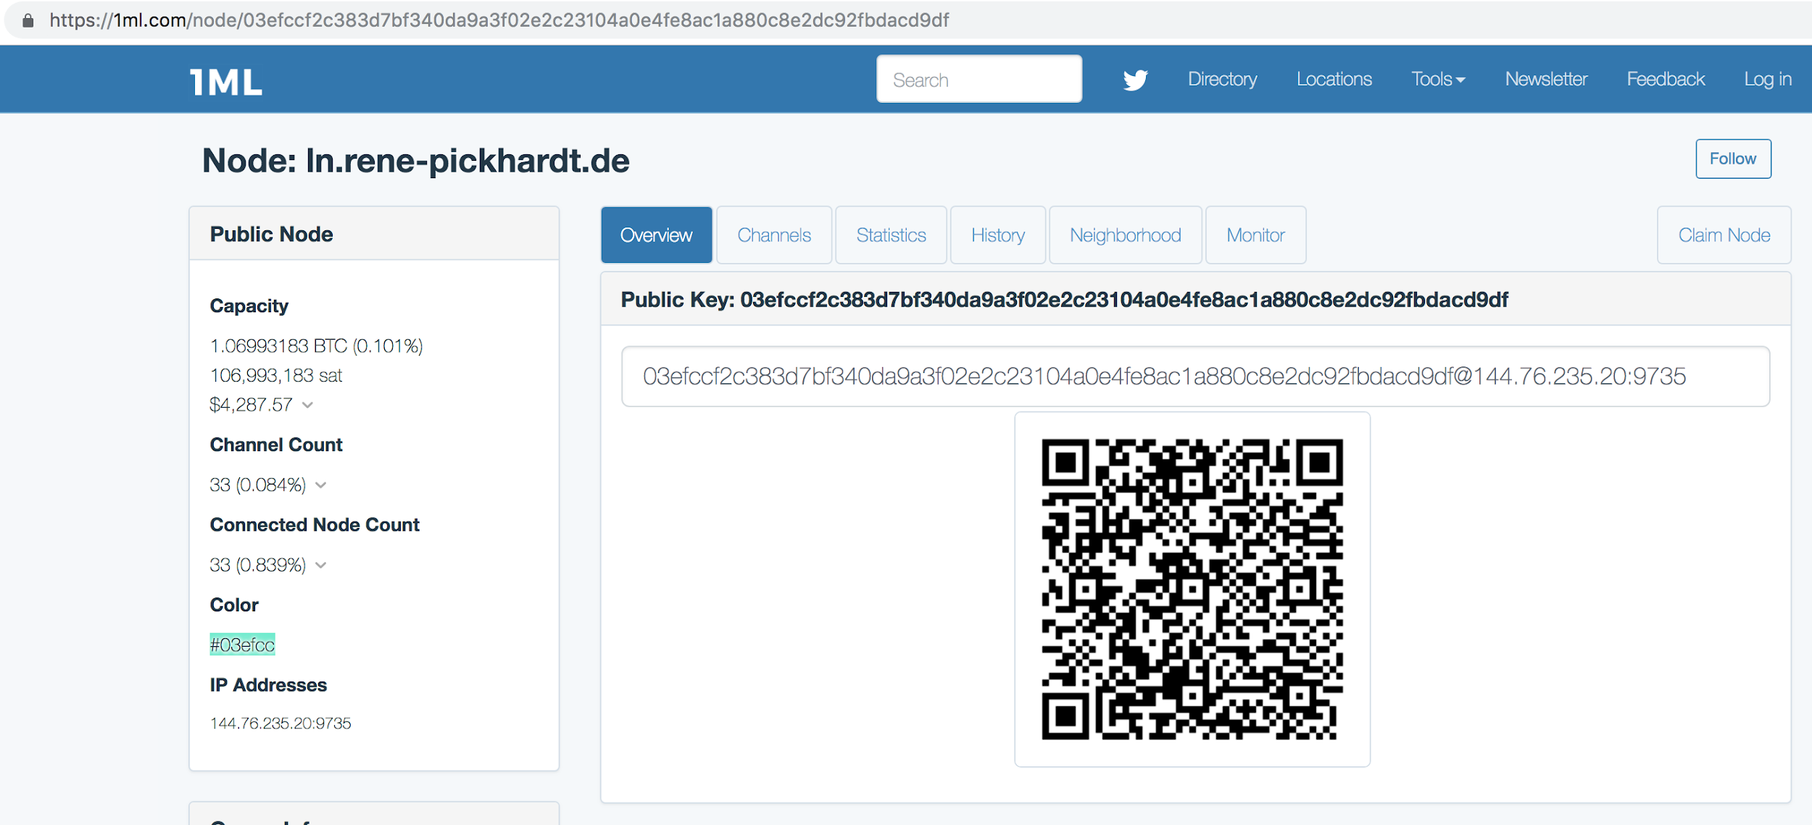

Slide 192
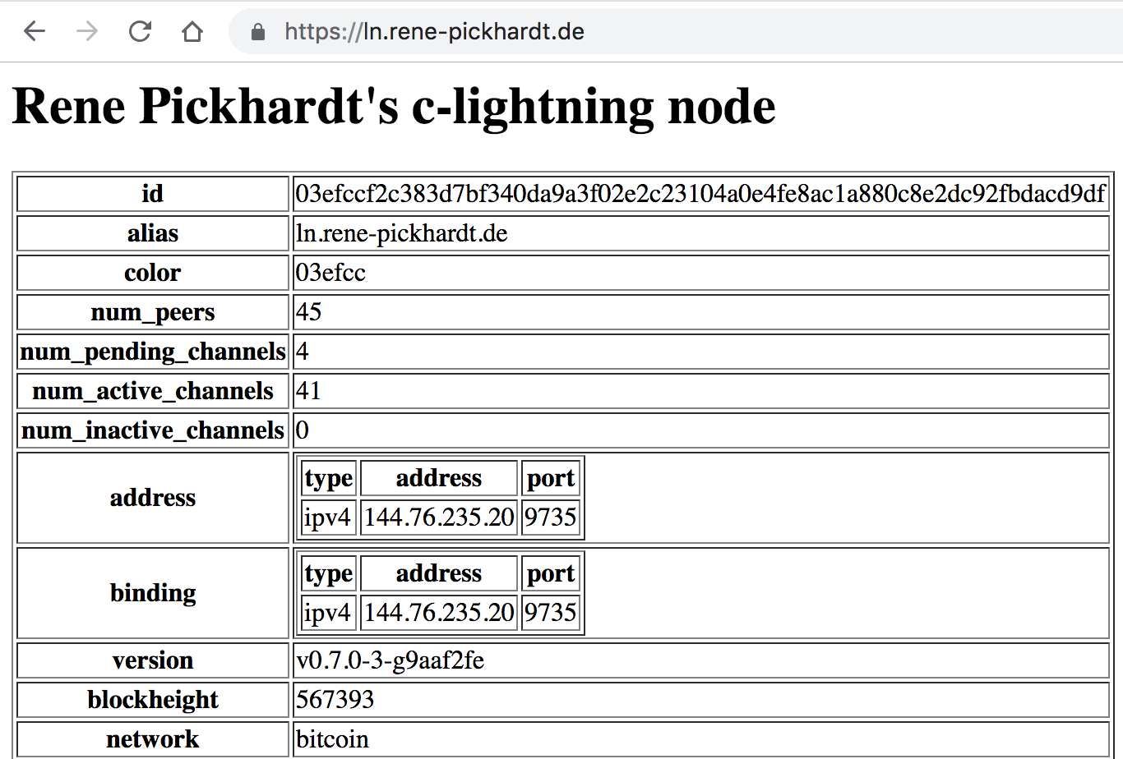
Demonstrating private Channels
Sh

Slide 193
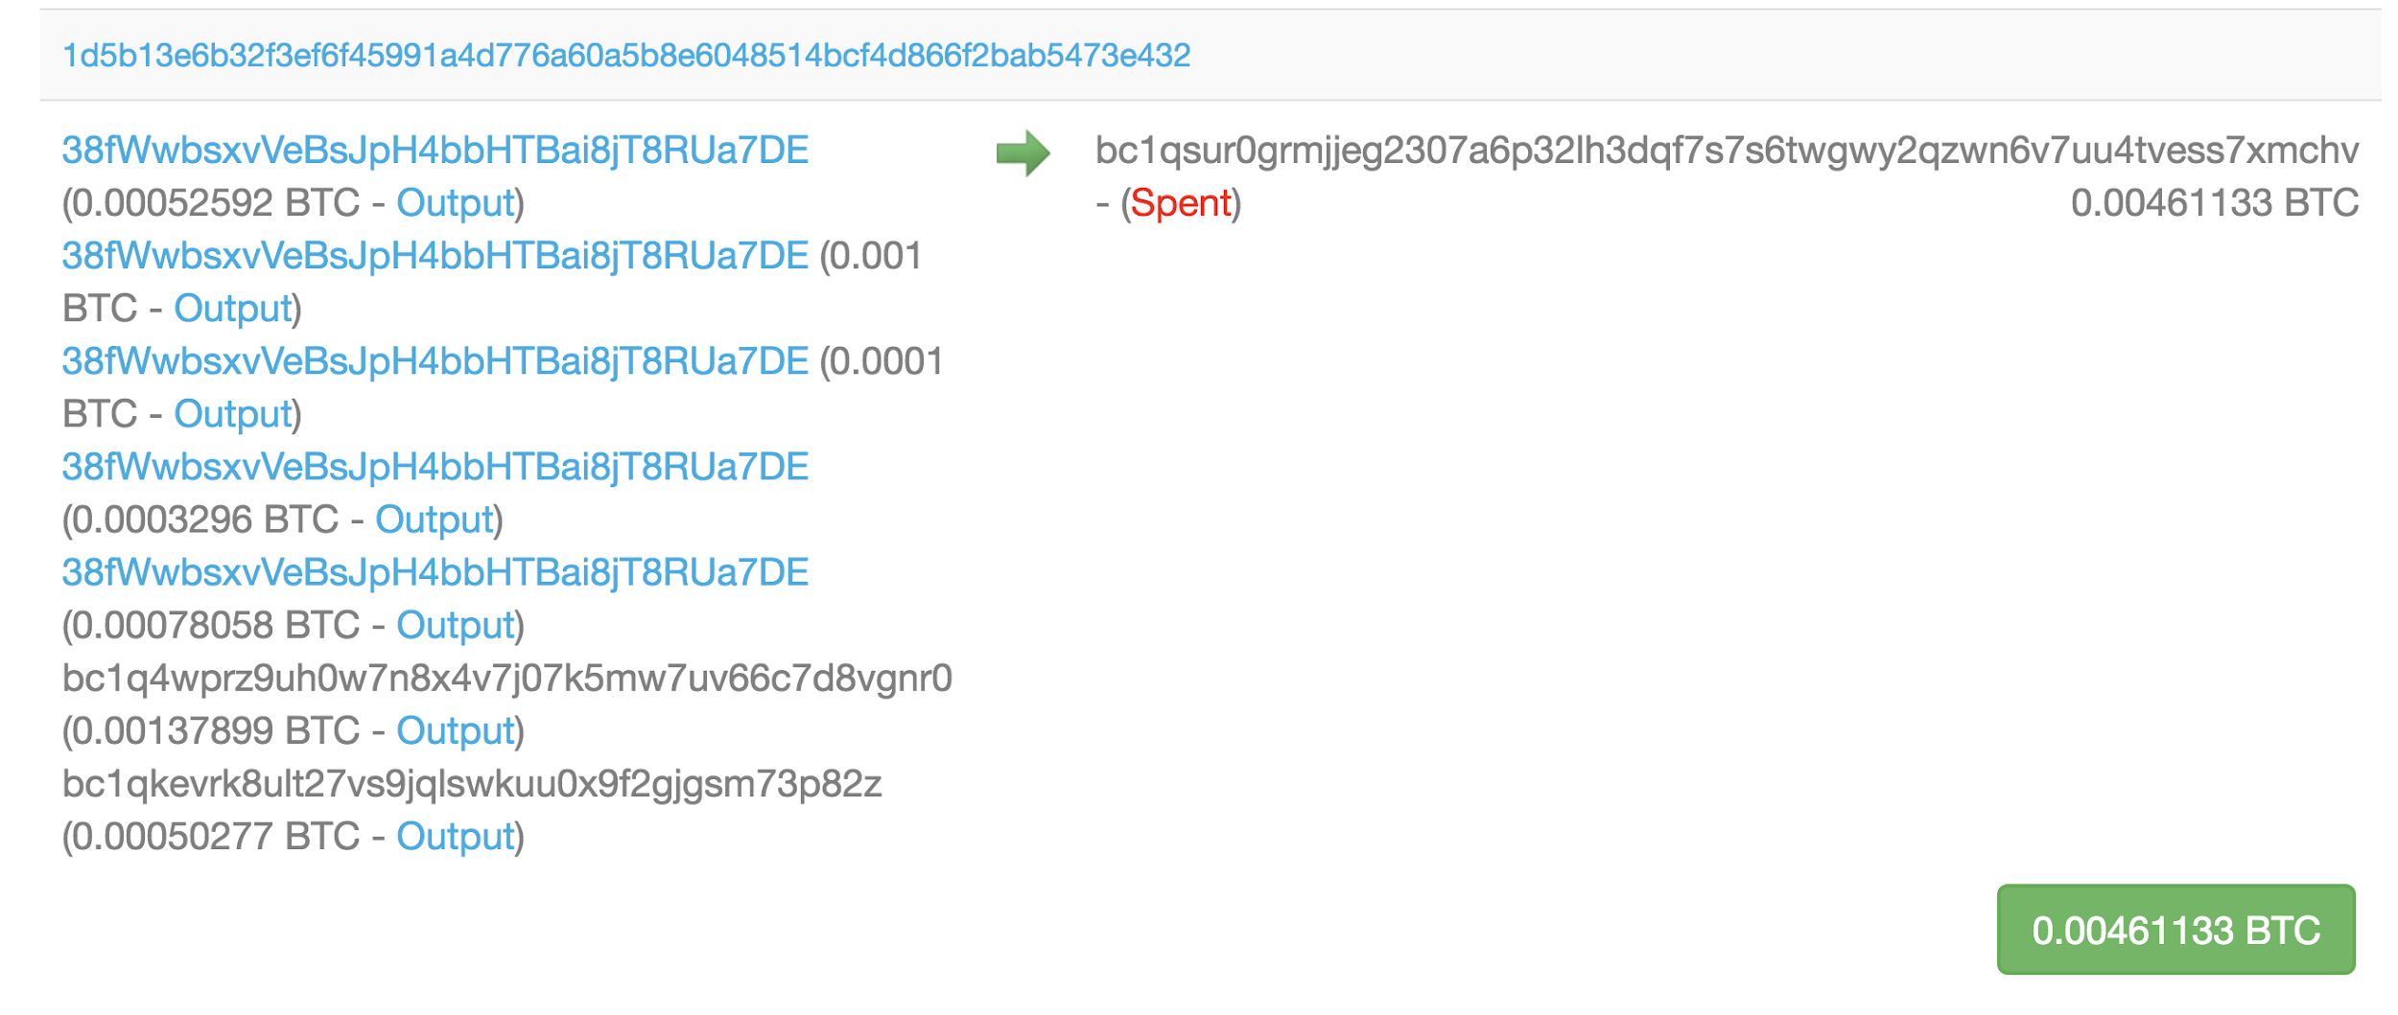
Transaction related to a Lightning network channel?
Tx-hash: 1d5b....e432

Slide 194
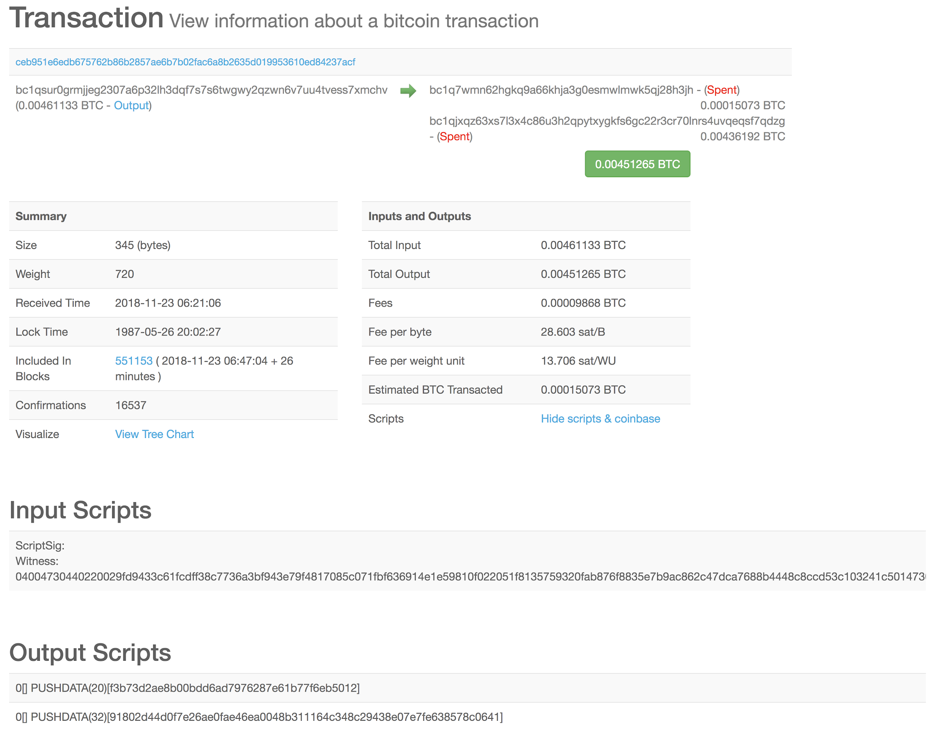
Spent by

Slide 195
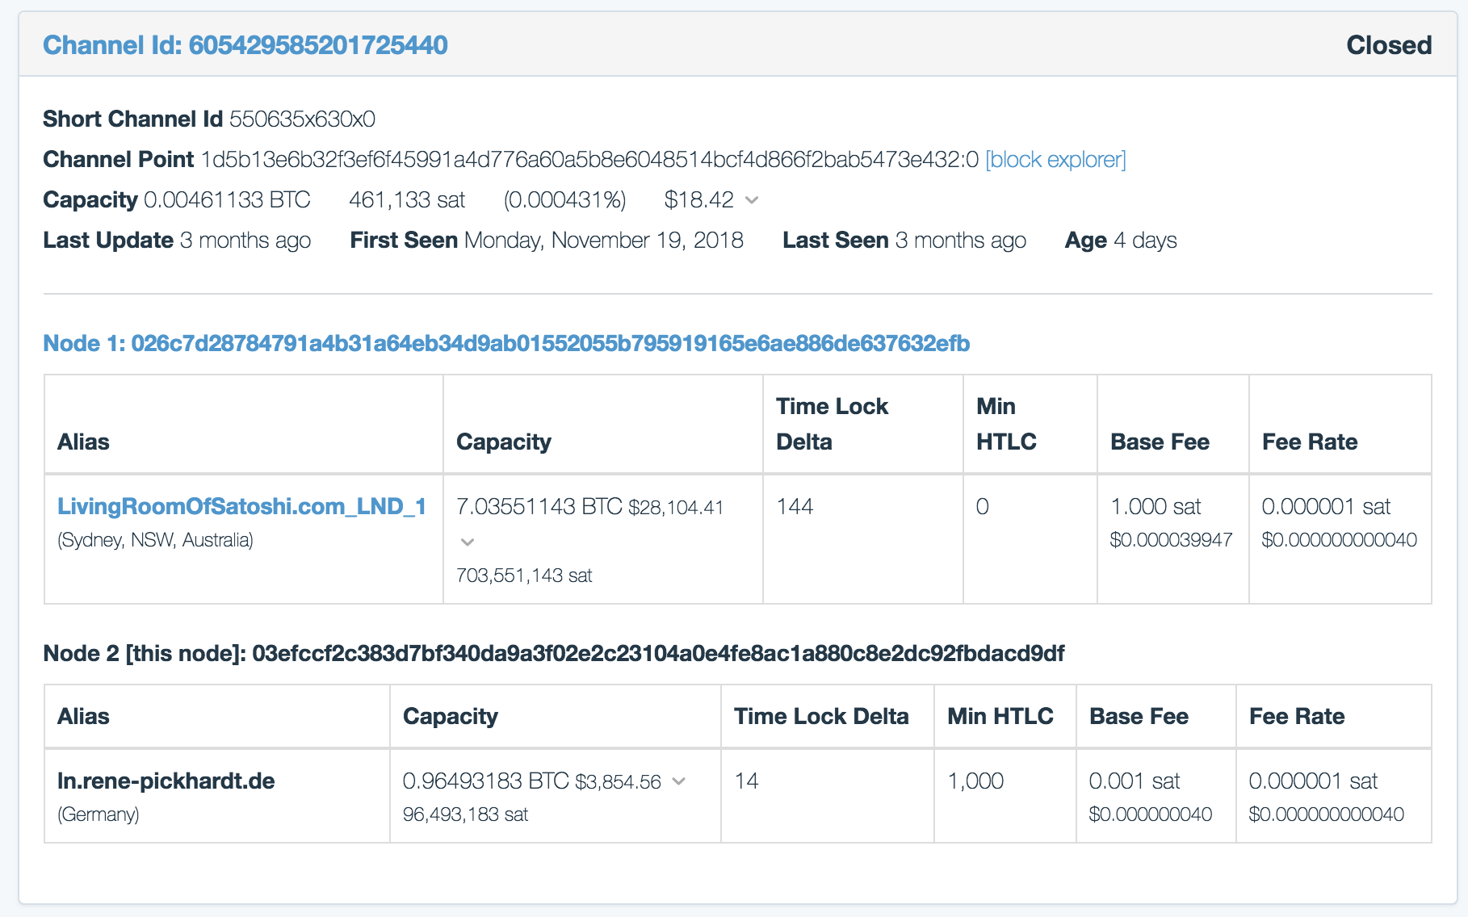
Spent by
Tx-hash: 1d5b....e432

Slide 196
Spent by
Tx-hash: 1d5b....e432

Slide 197
Lightning node on chain wallets
Currently don't seem to provide privacy features
Funding tx has
2-2 multisig output
Optionally a regular change output
Such tx do not have to be funding tx
Mutual close will be hard to connect to a channel
Unilateral / breach close could more easily be identified
Lightning nodes wallets could include privacy features in future
like coin join
Other measures from https://en.bitcoin.it/wiki/Privacy

Slide 198
Channel probing attack for channel balance
Source based routing was a requirement
An attacker can request routing a cycle route to herself
And never release the preimage
If route is successfully set up information about channel balance is revealed
This attack is free as
setting up htlcs comes at literally no cost.
Only networking & small computational overhead
This gives a lower / upper estimate about channel balances…
As long as JIT Routing is not implemented
Users might share channel balance for services like route / path finder

Slide 199
The Lightning Network a tool to increase privacy?
Single payments can be hidden and are not stored to the blockchain
Nodes can run on tor onions
Running nodes without announcing them or channel partners is possible
Rendez vous routing will increase such an operation by a lot
Payments are sent via onions and hard to trace, correlate
Scriptless scripts will allow for per hop preimages
No routing tables or public information about channel balances
Future AMP-Routing might create standard sized payments
making traffic analysis even more difficult as onions cannot be correlated
Random overpayment allowed by protocol to obfuscate onions
C-lightning has a configurable max fee rate that nodes are willing to pay
Overpayment will be between max accepted fee and the actual fee

Slide 200
Security breaches by poor implementations
(Chapter 8c)

Slide 201
Implementations can (deliberately) compromise privacy
Protocol does not guarantee perfect privacy
Remember IP addresses and Bitcoin addresses can be linked via gossip
Poor implementations yield a risk
Even without bad intend
Some points to watch out for will be discussed
The goal is to have a growing list of points to check for with the open source implementations

Slide 202
Not randomizing CLTV deltas in route construction
From Bolt 7 : routing gossip:
If a route is computed by simply routing to the intended recipient and summing the cltv_expiry_deltas, then it's possible for intermediate nodes to guess their position in the route. Knowing the CLTV of the HTLC, the surrounding network topology, and the cltv_expiry_deltas gives an attacker a way to guess the intended recipient. Therefore, it's highly desirable to add a random offset to the CLTV that the intended recipient will receive, which bumps all CLTVs along the route.
Possible infringement:
Create a popular implementation / plugin that uses the minimum CLTV deltas

Slide 203
Implementations avoiding random overpayments
From Bolt 4 : Onion Routing:
If the amount paid is more than twice the amount expected:
SHOULD fail the HTLC.
SHOULD return an incorrect_or_unknown_payment_details error.
Note: this allows the origin node to reduce information leakage by altering the amount while not allowing for accidental gross overpayment.
Possible infringement:
Create a popular implementation / plugin that never overpays.
Nodes do not have to do overpayments
C-lightning does random overpayment to an amount up to the maximum accepted fee rate for the payments
Other implementations could use other measures

Slide 204
Man in the middle attacks of the Noise protocol
From Bolt 08 : Transport
Authenticating each message sent ensures that a man-in-the-middle (MITM) hasn't modified or replaced any of the data sent as part of a handshake, as the MAC check would fail on the other side if so.
A successful check of the MAC by the receiver indicates implicitly that all authentication has been successful up to that point. If a MAC check ever fails during the handshake process, then the connection is to be immediately terminated.
This means that a poor implementation in which checking the MAC is omitted allows for man in the middle attacks
In my opinion unlikely to happen

Slide 205
Bolt 02 bolt 03 basepoints unpredictable commitment tx
The various _basepoint fields are used to derive unique keys as described in BOLT #3 for each commitment transaction. Varying these keys ensures that the transaction ID of each commitment transaction is unpredictable to an external observer, even if one commitment transaction is seen; this property is very useful for preserving privacy when outsourcing penalty transactions to third parties.
Possible infringement:
Don't follow the spec for key derivation (will not be detected)

Slide 206
Ephemeral keys on the Transport layer
Noise XK handshake uses ephemeral keys
It is not specified in a deterministic way which keys should be chosen
Possible infringement:
A node could reuse the ephemeral keys from onion routing
A node could reuse the commitment_base_points / secrets

Slide 207
Dual funded channels used to probe for offchain balance
Current dual funded channel proposal has no means of stopping to probe peers for their onchain liquidity

Slide 208
Security breaches by services
(Chapter 8d)

Slide 209
3rd party services for lightning can compromise privacy
General gist services increasing the user experience often do this by trading for data
We will explain how some services can explicitly be constructed to collect data
The thoughts here should be taken into consideration for any third party service and are not particular for services on top of lightning

Slide 210
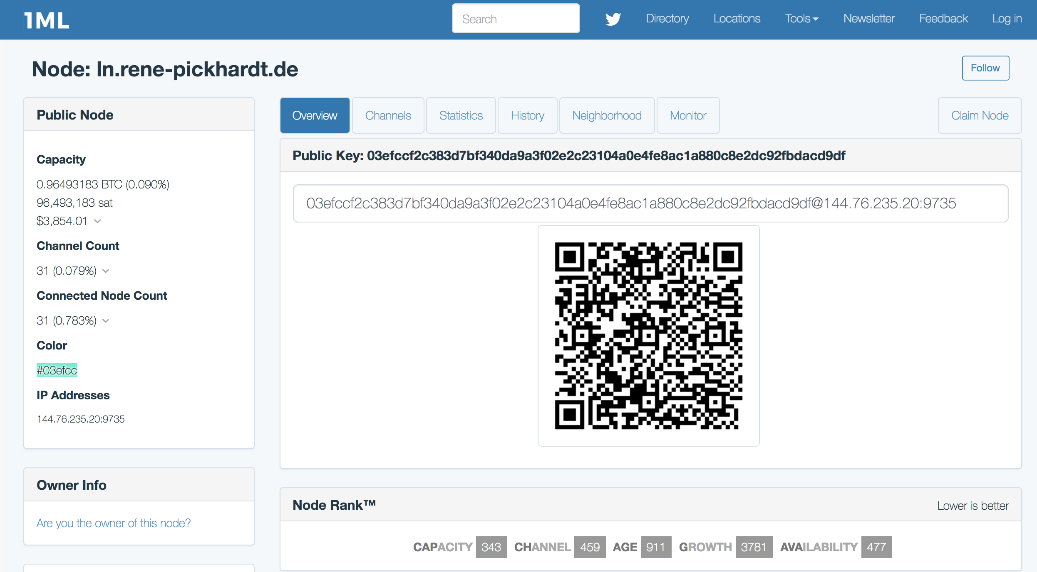
Lightning explorers like 1ml.com
Users can claim "their" node and provide authenticated meta data
Web users showing interest in certain nodes can be tracked

Slide 211
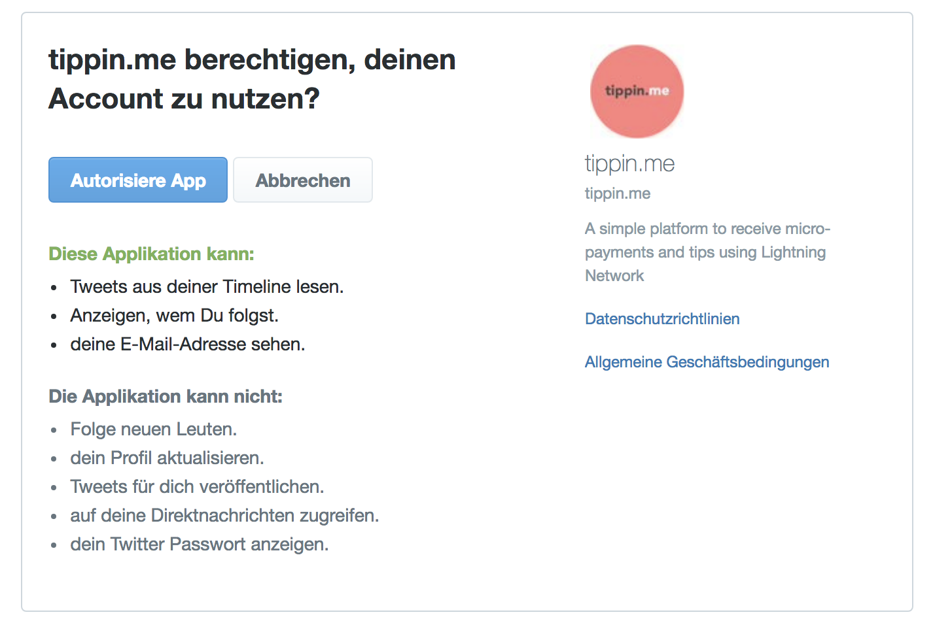
Custodial services with KYC are an obvious risk
Centralized exchanges implementing lightning
Custodial Wallets
Tip bots
Web services
Web shops
Payment provider

Slide 212
Decentralized Exchanges
Zigzag.io / sideshift.ai
Can correlate an onchain tx with a lightning invoice
Can collect meta data like IP address of the user
Submarine swaps
Same as zigzag.io

Slide 213
Implementations (wallets) / plugins
Implementations can obviously know anything
C-lightning offers plugins
Plugins can basically access all data of the node
Potential ideas for critical plugins
Routing service
Autopilot
Watchtower service
Escrow services

Slide 214
User Interfaces / UX improving tools
Remote control apps:
Can basically do everything a plugin / implementation can do
Examples
Spark-wallet (c-lightning)
Zap-wallet (lnd)
Hardware projects can theoretically lead to a security breach (examples which should checked before using them)
Casa node
Hodlhodl
Raspiblitz
Hardware wallets (work in progress)
Point of sale systems

Slide 215
References and helpful links
https://github.com/lightningnetwork/lightning-rfc
http://noiseprotocol.org/noise.html
https://www.youtube.com/watch?v=ceGTgqypwnQ (Noise explained)
https://www.youtube.com/watch?v=3gipxdJ22iM (Noise overview)
https://cypherpunks.ca/~iang/pubs/Sphinx_Oakland09.pdf (SPHINX Mix Format Paper)
https://www.youtube.com/watch?v=34TKXELJa2c (SPHINX Mix Format presented)
https://en.wikipedia.org/wiki/Poly1305
https://en.wikipedia.org/wiki/Salsa20#ChaCha_variant
https://tools.ietf.org/html/rfc7539 ChaCha20 and Poly1305 for IETF Protocols
https://www.youtube.com/user/RenePickhardt
https://bitcoin.stackexchange.com/questions/tagged/lightning-network
https://en.bitcoin.it/wiki/Script
https://en.bitcoin.it/wiki/Transaction
https://lightning.network/lightning-network-paper.pdf
https://en.wikipedia.org/wiki/Elliptic_Curve_Digital_Signature_Algorithm

Slide 216
Backup Slides

Slide 217
A standard Bitcoin Transaction has 6 data fields
( The following is a brief summary of https://en.bitcoin.it/wiki/Transaction#Input )
Version number (4 Bytes)
In-Counter (1-9 Bytes)
List of inputs (depending on the Value of <In-Counter>)
Out-Counter (1-9 Bytes)
List of Outputs (depending on the Value of <Out-Counter>)
Lock_time (4 Bytes)
(

Slide 218
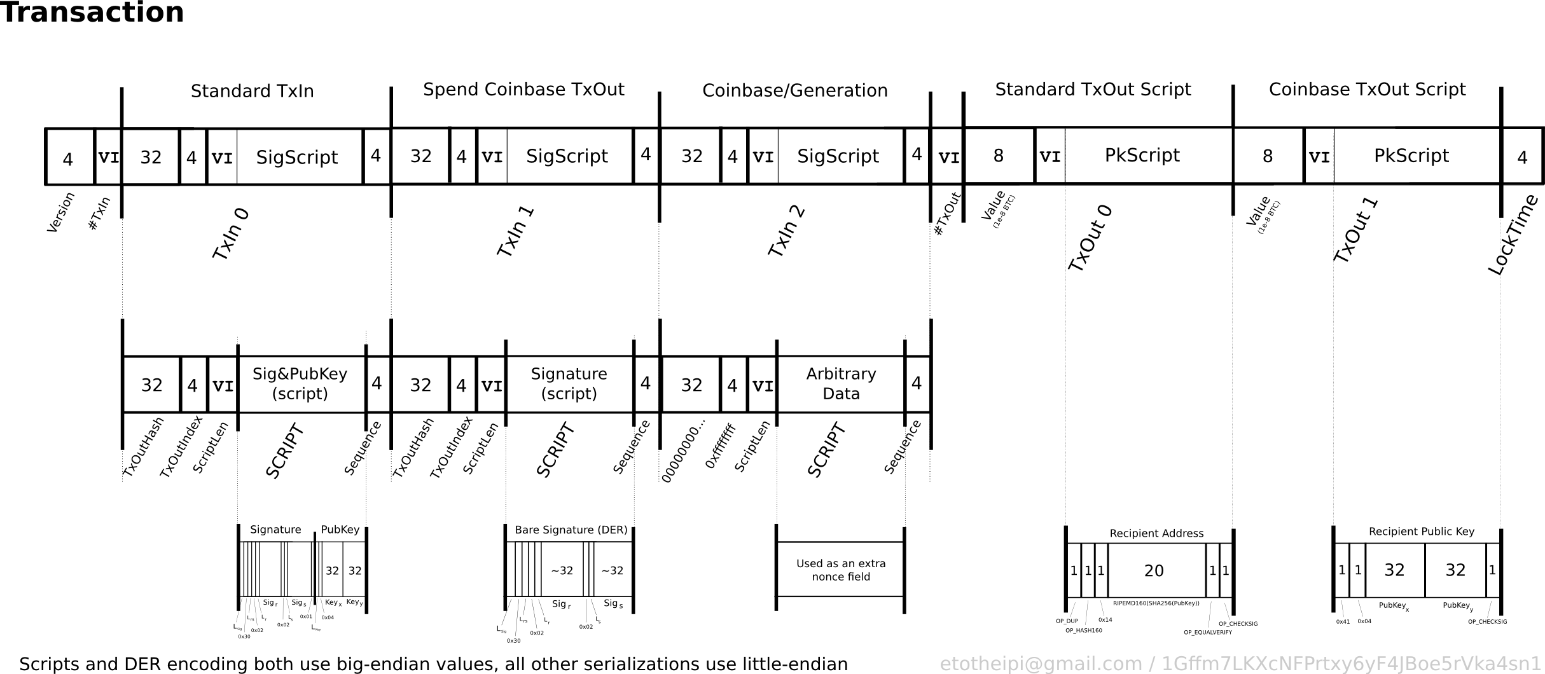
Bitcoin Transaction with 3 inputs and 2 outputs

Slide 219
Data consists mainly of executable scripts!

Slide 220
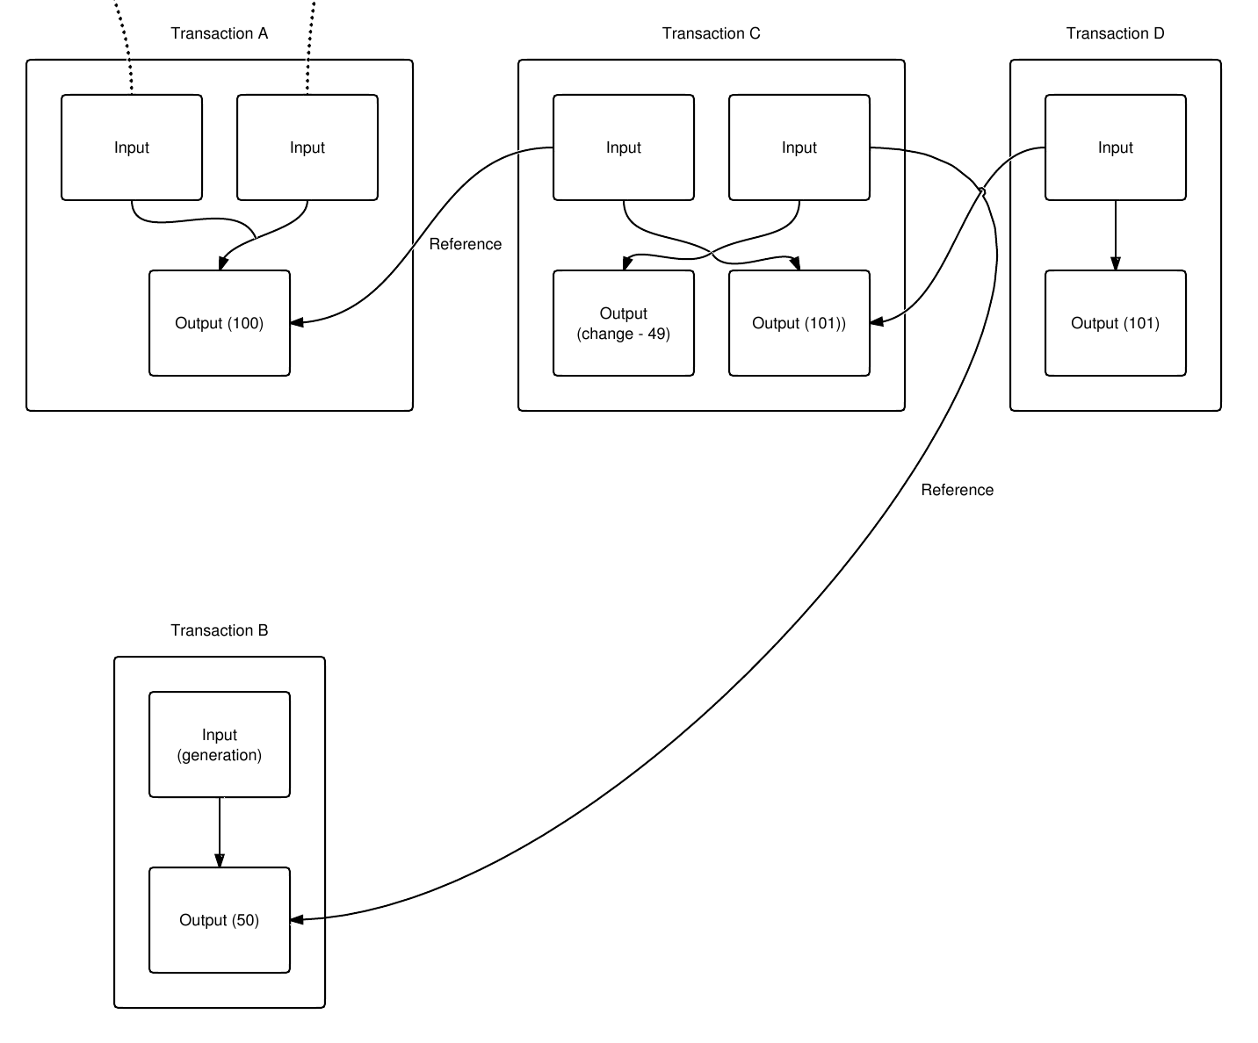
A chain of Bitcoin Transactions with 2 UTXO
Outputs are references by the inputs
The Script in the output defines how the transaction can be spent
Owning Bitcoins means being able to spend the output of an unspent transaction
Provide an input script
Concatenate it with with some outputscript of an unspent transaction
The combined Script needs to evaluate to True

Slide 221
Spending a Pay-to-PubkeyHash (standard TX)
ScriptPubKey (aka the Output Script)
OP_DUP OP_HASH160 <pubKeyHash> OP_EQUALVERIFY OP_CHECKSIG
ScriptSig: (aka the Input Script)
<sig> <pubKey>
Explainations
OP_CODES are the instructions of the script language within Bitcoin
<data> is depicted like html tags with lesser than and greater than signs
The complete script is concatenated as Input || Output and then being executed on a Stack machine
<sig> <pubKey> OP_DUP OP_HASH160 <pubKeyHash> OP_EQUALVERIFY OP_CHECKSIG
A video dissecting a P2PKH transaction: https://www.youtube.com/watch?v=1n4g3eYX1UI

Slide 222
Execution of Pay-to-PubkeyHash Script
<sig> <pubKey> OP_DUP OP_HASH160 <pubKeyHash> OP_EQUALVERIFY OP_CHECKSIG
Data is pushed on the stack
<sig>

Slide 223
Execution of Pay-to-PubkeyHash Script
<sig> <pubKey> OP_DUP OP_HASH160 <pubKeyHash> OP_EQUALVERIFY OP_CHECKSIG
Data is pushed on the stack again
<pubKey>
<sig>

Slide 224
Execution of Pay-to-PubkeyHash Script
<sig> <pubKey> OP_DUP OP_HASH160 <pubKeyHash> OP_EQUALVERIFY OP_CHECKSIG
The OP_CODE OP_DUP is being executed by pushing the top element to the stack again
<pubKey>
<pubKey>
<sig>

Slide 225
Execution of Pay-to-PubkeyHash Script
<sig> <pubKey> OP_DUP OP_HASH160 <pubKeyHash> OP_EQUALVERIFY OP_CHECKSIG
The OP_CODE OP_HASH160 is being executed:
It takes the top element of the Stack
<pubKey>
<pubKey>
<sig>

Slide 226
Execution of Pay-to-PubkeyHash Script
<sig> <pubKey> OP_DUP OP_HASH160 <pubKeyHash> OP_EQUALVERIFY OP_CHECKSIG
The OP_CODE OP_HASH160 is being executed:
It takes the top element of the Stack
The RIPEMD-160 Hash is calculated
By design of the input and output script this will be the Hash of the Public Key (aka the Bitcoin Address)
<pubKey>
<pubKeyHash>
<pubKey>
<sig>

Slide 227
Execution of Pay-to-PubkeyHash Script
<sig> <pubKey> OP_DUP OP_HASH160 <pubKeyHash> OP_EQUALVERIFY OP_CHECKSIG
The OP_CODE OP_HASH160 is being executed:
It takes the top element of the Stack
The RIPEMD-160 Hash is calculated
And the result is pushed back on the stack
By design of the input and output script this will be the Hash of the Public Key (aka the Bitcoin Address)
<pubKey>
<pubKeyHash>
<pubKey>
<sig>

Slide 228
Execution of Pay-to-PubkeyHash Script
<sig> <pubKey> OP_DUP OP_HASH160 <pubKeyHash> OP_EQUALVERIFY OP_CHECKSIG
Data is pushed on the stack again
<pubKeyHash>
<pubKeyHash>
<pubKey>
<sig>

Slide 229
Execution of Pay-to-PubkeyHash Script
<sig> <pubKey> OP_DUP OP_HASH160 <pubKeyHash> OP_EQUALVERIFY OP_CHECKSIG
OP_EQUALVERIFY checks if the two top elements of the stack are equal.
While checking the elements will be removed
Like the instruction set in the ALU of the CPU OP_CODES know how much data they need to consume (and will do so or fail otherwise)
<pubKeyHash>
<pubKeyHash>
<pubKey>
<sig>

Slide 230
Execution of Pay-to-PubkeyHash Script
<sig> <pubKey> OP_DUP OP_HASH160 <pubKeyHash> OP_EQUALVERIFY OP_CHECKSIG
OP_CHECKSIG evaluates that the PubKey which was the top element fits to the signature which was the 2. Element on the stack
If this fits together ownership is proven and the Transaction will be added to the block with a new Output script.
After being mined the transaction is now considered to be spent. Double spending cannot take place since the assumption was that the output was not spent yet.
<pubKey>
<sig>
<True>

Slide 231
The Bitcoin miners will build the next block
Collect published and valid transactions
In particular the hashes of the transactions
Most likely those that offer highest mining fees
Mining fees are leftovers of inputs which have not assigned to outputs
As many as there is space within the block
Start with one special transaction which has no input generating the block reward as an output
Take some additional meta data
The hash of the previous block
The nonce (and extra nonce as part of the coinbase)
Compute the merkle tree of all the hashes
Look out for a hash collision with respect to the mining difficulty
If your Tx was in: Congratulations you now sent bitcoins

Slide 232

Let's talk lightning!

Slide 233
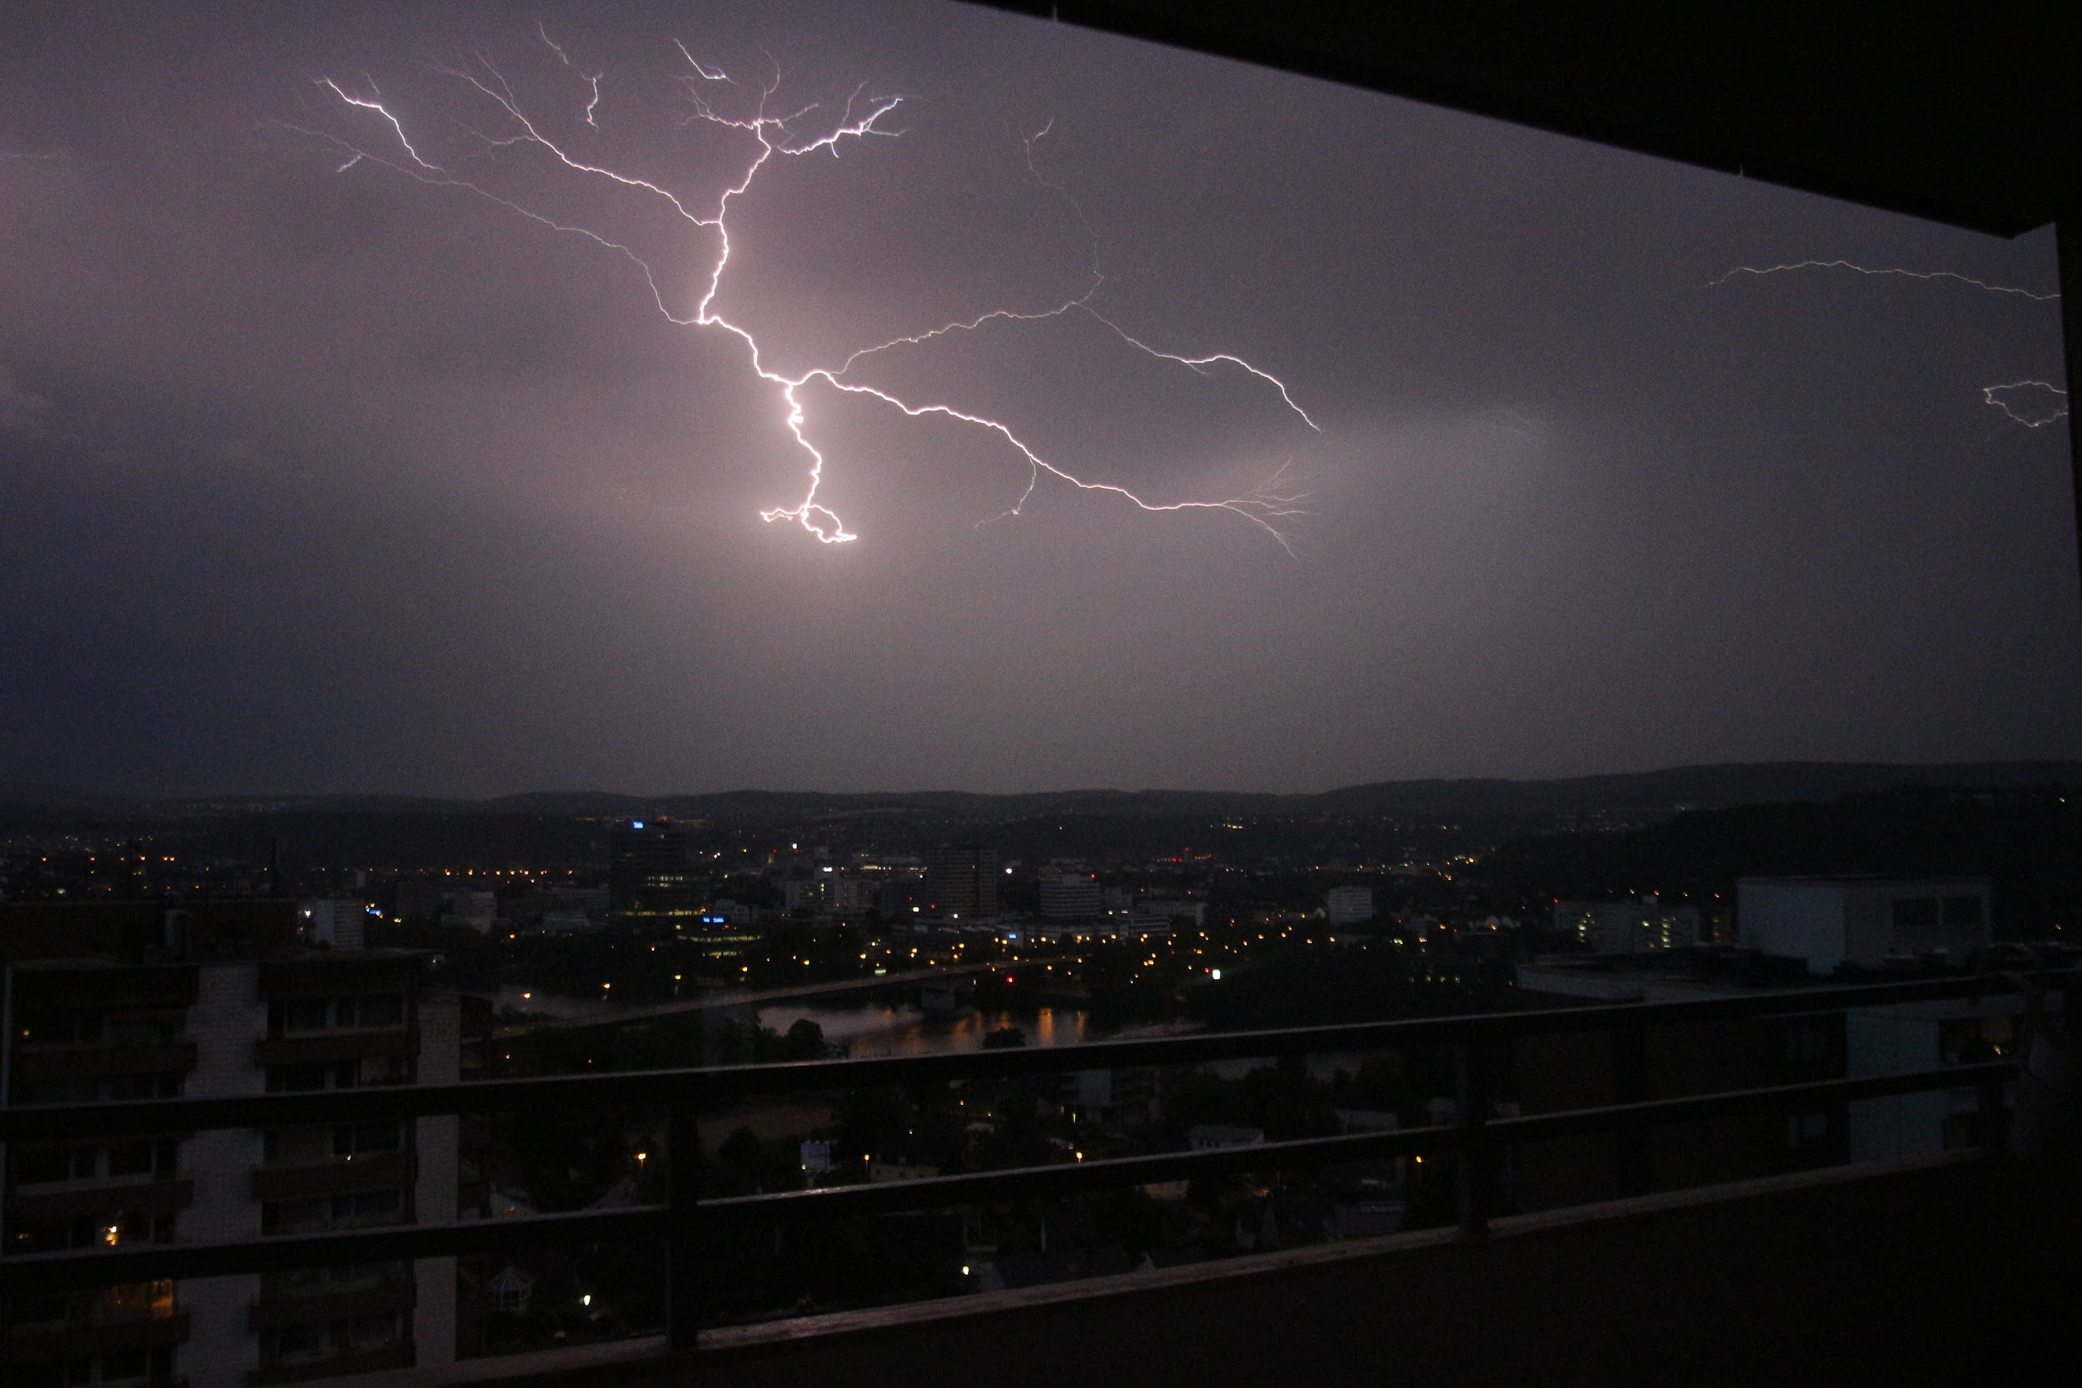
I love taking photographs of lightning bolts...

Slide 234
Copyright notice
This slide deck is openly licensed with a creative commons license CC-BY-SA-4.0.
The full license text can be found at: https://creativecommons.org/licenses/by-sa/4.0/legalcode
You are
free to
Share
Remixe
As long as you
Link to the original work
State my Name and Website
Mark changes in your derivative work
Use the same license for your derivative work
Screenshots in this slide deck are taken by me but the design of the websites might be protected by copyright
This slide deck uses parts of the lightning-rfc which is licensed as CC-BY (the lightning developers)
The full license text can be found at: https://creativecommons.org/licenses/by/4.0/legalcode
The graphics from the backup slides are taken from https://en.bitcoin.it/wiki/Transaction and are Public Domain
Thanks to Marietheres Viehler (aka journalspiration) for the design of the title slide.

Slide 235
About this slide deck
The purpose is to help spreading education about the Lightning Network Protocol so that the technology will be adopted more quickly by more people. This shall be my contribution to the Bitcoin / Lightning Network Community.
This slide deck - to the best of my knowledge - is the most comprehensive work making an introduction to the BOLT standard. I will hold several talks about this slide deck in Juni 2019 at the Bitcoin / Lightning Residency organized by Chaincodelabs who will also record the talk. So watch out for them because actual presentations of the slide deck will probably be more valuable than just the slides you're holding in your hand.
The slides are part of my effort to create a book about the lightning network. You can follow that effort at: https://github.com/renepickhardt/The-Lightning-Network-Book or you can support the effort at my fundrasing pages at: https://tallyco.in/s/lnbook or at: https://www.patreon.com/renepickhardt or at 1GZx8tWgDd21Rd8b1QdMrzdZGHgyfVkzaD part of this effort also consists of creating video tutorials and teaching materials on my Youtube Channel over at: https://www.youtube.com/user/RenePickhardt
This work was funded (sorted by amount of contribution from top to bottom) by: Me personally, fulmo.org, everyone who contributed to the above mentioned fundraiser and George Danzer.
Thank you to the lightning Developers and people in various telegram groups for helpful discussions

